Slide 1

Data and System Improvement Working Group
Michele Fuller-Hallauer
Stacy DiNicola

Slide 2
Purpose
The Data & System Improvement Working Group is tasked with reviewing and analyzing data that will assist the CoC in making data-informed decisions.
Review all data including homeless-related and other community indicators
Receive reports from the HMIS and Census Planning working groups
Oversee the implementation of the annual Point In Time (PIT) Count
Share findings and recommendations to the relevant working groups and provide updates to the SNH CoC Board
Notes:
The Data & System Improvement Working Group is tasked with reviewing and analyzing data that will assist the CoC in making data-informed decisions.
In order to do that we:
Review all data including homeless-related and other community indicators
Receive reports from the HMIS and Census Planning working groups
Oversee the implementation of the annual Point In Time (PIT) Count
Share findings and recommendations to the relevant working groups and provide updates to the SNH CoC Board

Slide 3

Activities
Review and analyze the annual homeless census and survey data
Develop recommendations for funding priorities for local applications
Evaluate the unmet need calculation formula
Ensure the annual point in time count is conducted in accordance with HUD guidelines
Collaborate with other working groups
Ensure compliance with the HEARTH Act
Notes:
Some of the activities that the Data and System Improvement Working Group works on include:
Complete the review and analysis of the annual homeless census and survey data
Develop recommendations for funding priorities for local applications based on available data – provide recommendations to Evaluation Working Group
Evaluate the unmet need calculation formula to determine the needs in our system
Ensure the annual point in time count is conducted in accordance with HUD guidelines and that results are analyzed and reported to the appropriate entities (ie. HUD, SNH CoC Board, etc.)
Collaborate across other working groups and share information for effective implementation and strategies as well as open and inclusive opportunities for CoC members to participate and be actively involved – work closely with Evaluation and Monitoring Working Group
Ensure compliance with the HEARTH Act on data requirements

Slide 4
Governance
Membership – Stakeholders represent those who experience homelessness and related systems as it relates to data collection, analysis, system performance and system improvement.
Meetings – Occur biweekly on Mondays from 8:30am-9:30am
Leadership – The current leadership is Michele Fuller-Hallauer and Stacy DiNicola
Decision Making – Decisions will be made by consensus of those in attendance. In the event consensus cannot be reached, any member of the group can call for a formal vote.
Notes:
Membership – Members of the DSIWG include stakeholders that represent those who experience homelessness and related systems as it relates to data collection, analysis, system performance and system improvement.
Meetings - Meetings occur biweekly on Monday, 8:30 am -9:30 am.
Leadership: The current leadership for the DSIWG is Michele Fuller-Hallauer mhf@clarkcountynv.gov and Stacy DiNicola Stacy.DiNicola@cityofhenderson.com
Decision Making: Decisions will be made by consensus of those in attendance. In the event consensus cannot be reached, any member of the group can call for a formal vote. Regardless of the number of members from the same Agency, each Agency in attendance will receive one (1) vote. If there is more than one representative present for any Agency, those members will confer and are entitled to one vote.
A high-level overview of discussions and decisions that impact services to individuals experiencing homelessness can be found in the DWG monthly report presented to the SNH CoC Board.
All fiscal and policy matters will be forwarded to the SNH CoC Board with recommendation from the Data and System Improvement Working Group.

Slide 5

Data & Dashboards
Notes:
Some of the data and reports that we review includes:
Data from the annual point in time count
Data from the housing inventory count
Data from the longitudinal systems analysis
System Performance Measures
Built for Zero Dashboards
Most recently – Operation HOME! Data Dashboards

Slide 6

Operation Home! Dashboard
Southern Nevada Continuum of Care
OH! 2021-2022
Notes:
Hello everyone, my name is Matt Manlangit, CoC Data Analyst for Clark County Social Service. Today, I will be presenting the Operation Home dashboard: What it is, the questions it can answer, and the overall goal of having one.

Slide 7

Thank Yous and Shout outs
Mike Reed – Bitfocus
Ian Costello – CSH
Joan Domenech – CSH
Susan Starrett - CSH
Notes:
Before I proceed, I would like to give a huge thank you to the following people who made the dashboard possible. The dashboard is testament to their hardwork and constant communication.
Mike Reed from Bitfocus
Ian Costello, Joan Domenech, and Susan Starrett from the Corporation for Supportive Housing or CSH.
Now without further ado. Let’s begin.

Slide 8
What is Operation Home?
Operation Home! is Southern Nevada’s Continuum of Care initiative to house 2022 homeless clients by the end of the year 2022.
Official tracking of services started 7/1/2021
Are we on track to meet this goal?
Notes:
Let’s get started.
First a brief recap on what Operation Home is. Operation Home is a Continuum of Care initiative to house 2022 homeless clients by the end of the year 2022. This change is made possible by the influx of new funding from COVID related programs and grants as well as investments to Southern Nevada’s infrastructure.
The first half of 2021 was dedicated in the planning phase of the initiative. Our clients started getting assessed, referred, enrolled, and housed under Operation Home starting 7/1/2021.
Many of us have one thing in mind regarding Operation Home, are we on track in meeting this ambitious goal? How do we make sure we achieve this and at the same time be of great service to our clients?

Slide 9

What is the Operation Home Dashboard?
Data intelligence dashboard powered by Tableau
Aimed at tracking the Operation Home! Housing goal
Focuses on upholding the CoC’s dedication in providing equitable services.
Notes:
Enter the dashboard.
The Operation Home! Dashboard is a data intelligence platform aimed at tracking Southern Nevada’s goal of housing 2022 homeless clients by the end of the year 2022. The dashboard is powered by the business intelligence platform Tableau. All data that will be posted will be taken from the Homeless Management Information System or HMIS of Southern Nevada’s Continuum of Care.
A separate, Operation Home! Dashboard Guide will be posted alongside the dashboard. The guide was made in order to help providers, stakeholders, clients, and any member of the public to read and understand the presented data. The dashboard will be constantly reviewed and refined based on data requested by stakeholders and the public.

Slide 10
Operation Home! Dashboard Features
Performance overview of the Operation Home! Initiative
Total of 6 tabs, each focusing on a specific component of Operation Home!
The ability to further “drill down” on the presented data via filters
The ability to view the data in a racial/gender equity lens
Notes:
What exactly can we see and access in the Operation Home Dashboard? What is the goal of the dashboard
The first is to provide a performance overview of the OH! Initiative. It is to make sure we are on track on achieving the goal
The second is looking at different components of the OH! Initiative and being able to assess and analyze each step in the Coordinated Entry process of it. There are 6 major tabs in the OH! Dashboard.
The third is to provide a more in depth look at the data and be able to drill down / isolate specific data points via filters located in each section.
The last but not the least is the ability to look at each data in a racial/gender equity lens. We want to be sure that we are upholding the CoC’s dedication to provide services equitably amongst our clients.

Slide 11
Let’s take a look at the dashboard!
Notes:
Now let’s take a look at the actual dashboard and the 6 major tabs that come with it. Please be aware that the data shown here right now are SAMPLE data and are not actual data pulls from HMIS. We want to present the structure of the dashboard first.

Slide 12
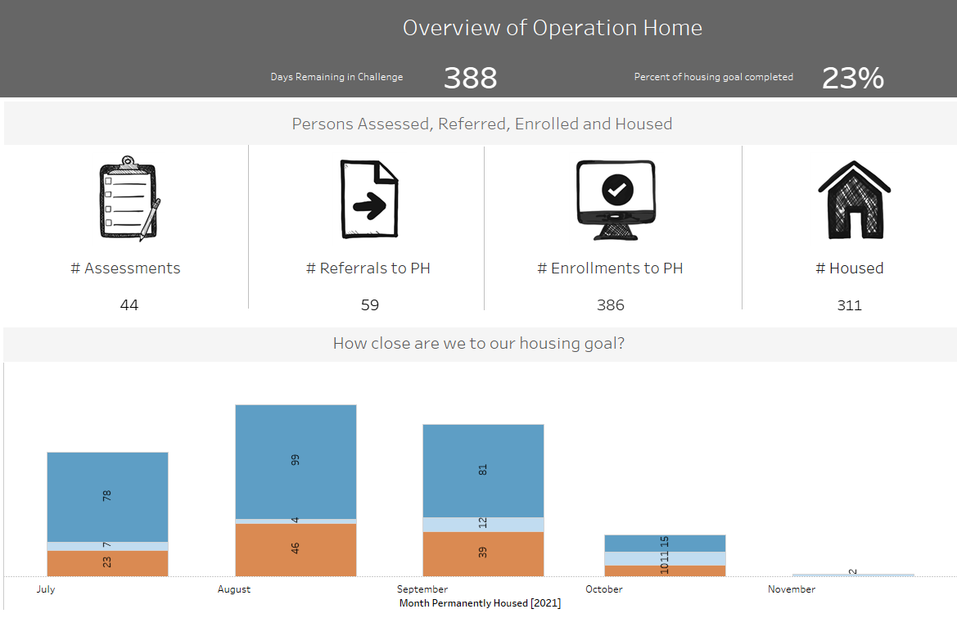
Tab 1: Operation Home Overview
Notes:
The first tab is the Overview of the Operation Home. The Overview of Operation Home tab contains the general performance metrics of the OH! Initiative. This tab shows the total number of clients that have been assessed, referred, enrolled, and housed under the Operation Home banner.

Slide 13
Notes:
This is what the Overview of Operation Home tab would look like once it is live in the Help Hope Home website. There are 3 major sections inside this tab.
Overview of Operation Home
Days remaining in Challenge counts down the available days left before the end of 2022
Percent of housing goal completed – this metric counts how many unique, unduplicated clients have been housed its percentage compared to the 2022 housing goal.
Persons Assessed, Referred, Enrolled, and Housed
# of Assessments - Total unduplicated # of clients who have been assessed using either the CHAT, Family CHAT, or Youth CHAT
# of Referrals - Total unduplicated # of clients who have been referred to a permanent housing program.
# of Enrollments - Total unduplicated # of clients who have been enrolled in a permanent housing program.
# of Housed - Total unduplicated # of clients who have been successfully housed by having a registered move-in date to their new housing structure or have exited to a housed status.
How close are we to our housing goal?
The bar graph will show the number of unduplicated clients that have been housed for that month only. The bar for each month is divided into 3 sections: Permanent Housing with Subsidy, Permanent Supportive Housing, and Rapid Rehousing

Slide 14
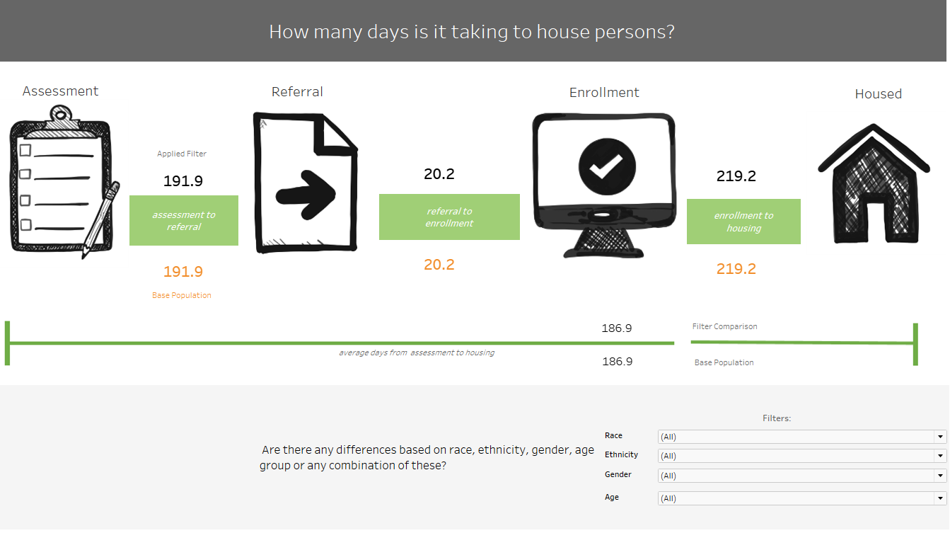
Tab 2: Coordinated Entry Flow
Notes:
The Coordinated Entry Flow tab focuses on showing the average days a client spends between the major Coordinated Entry steps. This includes the average days between Assessment to Referral, Referral to Enrollment, and Enrollment to housing.

Slide 15
Notes:
This is what the Coordinated Entry Flow tab would look like once the dashboard is active in the Help Hope Home website. There are 2 major sections in this tab.
How many days is it taking to house persons?
The graphic will show the average days a client is spending on a specific step in the Coordinated Entry process before proceeding to the next. The number under the “applied filter” label shows the average days spent by a client based on any applied filter selected. If you select a specific race/gender/ethnicity/age range, that number will change to show the average days in that step for that demographic. The number above the “base population” label is the average number of days for the whole Operation Home client population.
Are there any differences based on race, ethnicity, gender, age group or any combination of these?
This section allows the user to select filters based on the demographic data points mentioned. This allows the user to compare the average days spent of a certain demographic versus the overall base population. Any filter you select here changes the number of the applied filter on the above graphic.

Slide 16
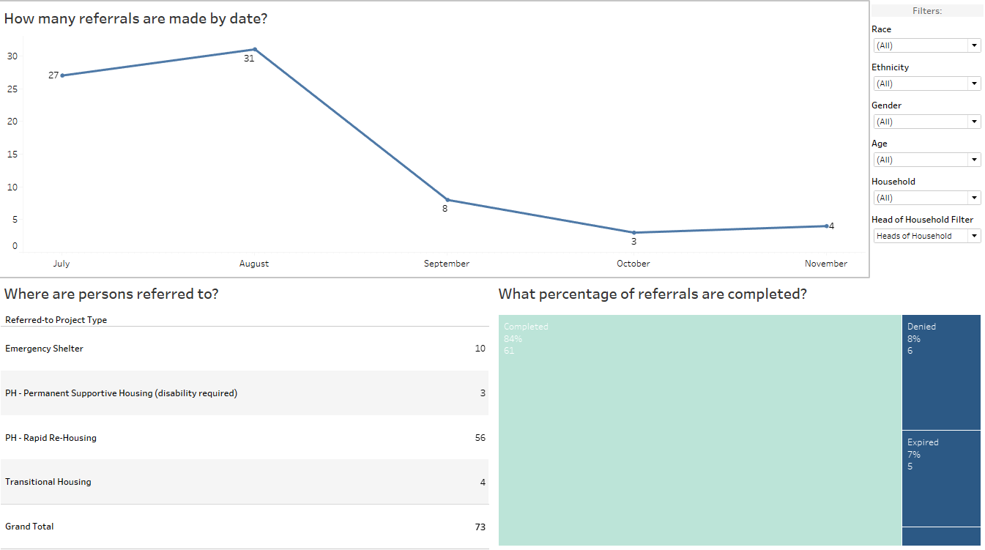
Tab 3: Referrals
Notes:
The Referrals tab focuses on presenting data on the referral phase of the Coordinated Entry process. This tab will show users the monthly number of referrals, which housing project type the clients have been referred to, and the percentage of referrals that have been completed or otherwise.

Slide 17
Notes:
This is what the Referrals tab would look like once the dashboard is live in the Help Hope Home site. There are 3 major sections in this tab.
Referrals Tab Sections:
How many referrals are made by date?
The line graph shows the monthly, unduplicated number (for that month) of clients that have been referred to a housing program.
Where are persons referred to?
The chart shows the total number of clients that have been referred to a specific housing project type.
What percentage of referrals are completed?
The graph shows the percentage of referrals that either have been successfully completed, have been denied by the provider, expired, and pending action.

Slide 18
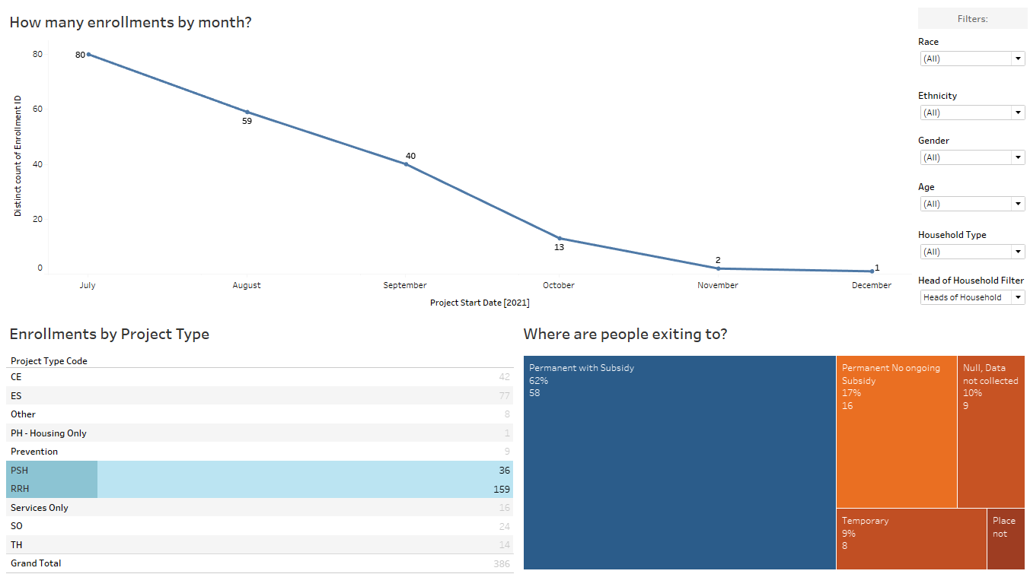
Tab 4: Enrollment
Notes:
The Enrollment tab focuses on presenting data on the enrollment phase of the housing process. This tab will show users the monthly number of enrollment, which housing project type the clients have been enrolled to, and the where the clients end up going once they have “exited” from their enrolled programs.

Slide 19
Notes:
This is what the Enrollment tab would look like once the dashboard is live in the Help Home site. There are 3 major sections in this tab.
Enrollment Tab Sections:
How many enrollments by month?
This line graph shows the monthly, unduplicated number (for that month) of clients that have been enrolled to a specific housing program AND/OR other homeless services.
Enrollments by Project Type
The chart shows the total number of clients that have been enrolled to a specific housing project type. Users can also select other homeless service project types to take a closer look.
Where are people exiting to?
This graph shows the percentage breakdown of clients based on their housing status upon “exiting” from their enrolled programs. A client exits their program when they have completed the housing steps , thus moving in to their new home OR if they have to exit early for different reasons.

Slide 20
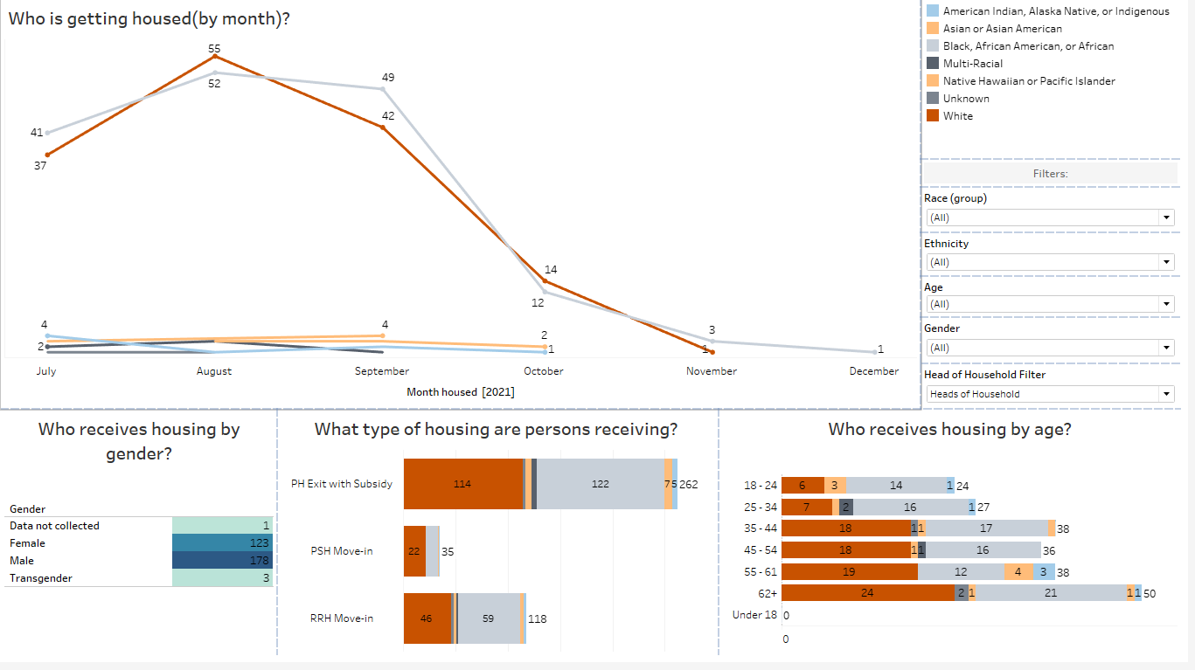
Tab 5: Housing
Notes:
The Housing Tab focuses on presenting data at the housing phase of the housing process. This tab shows the month by month total of clients that have been housed, demographic breakdown of those housed clients, as well as the housing project type that they have been housed under.

Slide 21
Notes:
This is what the Housing tab would look like once the dashboard is active on the HHH Site. There are 4 major sections in this tab.
Who is getting housed?
This line graph shows the monthly, unduplicated number (for that month) of clients that have been housed under a housing program. The data is broken down by race.
Who received housing by gender?
This chart shows the total unduplicated number of clients that have been housed under a housing program and then broken down by the client’s declared gender.
What type of housing are persons receiving?
This bar graph shows the total unduplicated number of clients that have been housed under a housing program OR exited to a permanent housing status but with a known housing subsidy.
Who receives housing by age?
This bar graph shows the total unduplicated number of clients that have been housed under a housing program and then broken down by the client’s age range upon being housed.

Slide 22
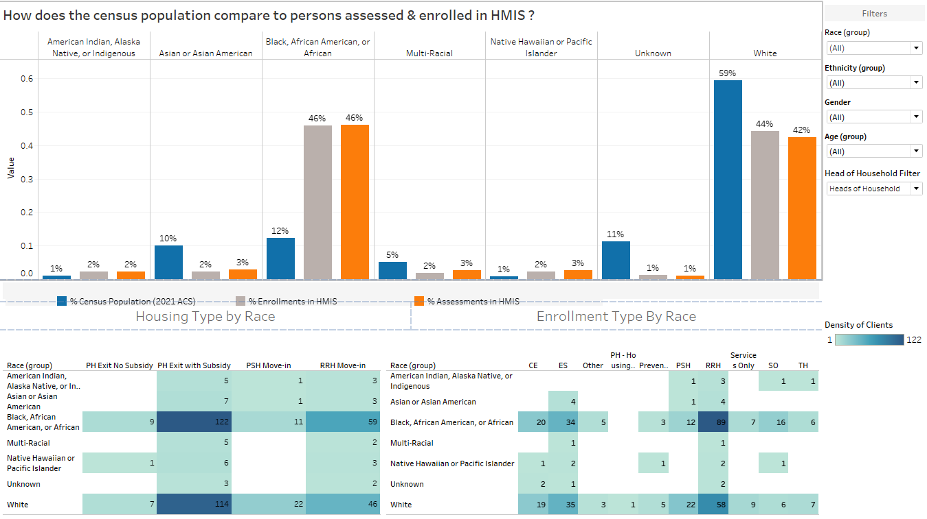
Tab 6: Measures by Race (CE)
Notes:
The Measures by Race (CE) tab aims to uphold the Continuum of Care’s goal to provide equitable services by featuring demographic data from the whole housing process / Coordinated Entry (CE) system. This tab looks at clients that have been assessed and enrolled and how they fare compared to the most recent general census population.

Slide 23
Notes:
This is what the Measures by Race (CE) tab would look like once the dashboard is live on the HHH Site. There are 3 major sections in this tab.
How does the census population compare to persons assessed and enrolled in HMIS?
This array of bar graphs aim to analyze the racial equity of our homeless system compared to the general Southern Nevada population. The assessment data shows the racial demographic of clients entering the homeless system. The enrollment data shows the racial demographic of clients that are being accepted and helped in our various housing programs.
Housing Type by Race
This chart displays the total, unduplicated number of clients that have been housed in various housing project types broken down by race.
Enrollment Type by Race
This chart displays the total, unduplicated number of clients that have been enrolled in different homeless system services broken down by race.

Slide 24
Frequently Asked Questions
Where do we pull the data from?
Data is pulled from HMIS and shows data from OH! Start Date (7/1/2021) to the previous month of the current date.
Does the dashboard ensure privacy of clients’ information?
There are no PIIs when we pull the data from HMIS. All data presented are aggregated.
When can we start looking at the dashboard?
The dashboard will be made available to the public at the beginning of 2022.
I have questions or concerns. Who do I contact?
Send an email to helphopehome@clarkcountynv.gov
Notes:
Now to tackle some frequently asked questions about the dashboard.
Where do we pull the data from?
Data is pulled from HMIS and all data presented are HMIS data. The dashboard will show data from the beginning of the OH! Tracking date (7/1/2021) up to the previous month of the current date.
Does the dashboard ensure privacy of clients’ information?
When we pull the data from HMIS and upload it to Tableau, there are no PIIs on the spreadsheets to begin with. The client’s Unique Identifier is what we use to ensure non-duplication of data. We also make sure that all data presented are aggregated.
When can we start looking at the dashboard?
The dashboard will be posted to the Help Hope Home site at the beginning of 2022. Our aim it so have it on the site at the first week of January for public consumption.
I have questions or concerns. Who do I contact?
The dashboard will continue evolve and be refined based on public and stakeholder feedback. If you have any questions, concerns, inputs or requests, please feel free to send an email to HHH’s official email address: helphopehome@clarkcountynv.gov

Slide 25

QUESTIONS?

Slide 26

Thank you!
Notes:
That concludes my presentation. Thank you!

Slide 27
Join the Data & System Improvement Working Group
Meet on Mondays at 8:30am-9:30am
Contact Michele Fuller-Hallauer - mhf@clarkcountynv.gov

