Slide 1

Report of the Working Group to Address Homelessness
Assembly Bill 73
Tim Burch, Administrator of Human Services
December 10, 2020

Slide 2
Assembly Bill (AB) 73
Creation of a temporary working group in Clark County
Working Group to Address Homelessness
Multijurisdictional
Working Group Responsibilities
Focus on collaborative response to reduce homelessness
Identify sources of funding to implement recommendations
Local Government
Community Members
Required group to prepare and submit a report of recommendations
Notes:
The Working Group to Address Homelessness was a product of Assembly Bill (AB) 73 from the 80thSession of the Nevada Legislature, and was a multijurisdictional effort comprised of individuals representing local government and community members that work on issues involving homelessness.
The Working Group was responsible for focusing attention and providing a report on methods to reduce homelessness, as well as identifying sources of funding to implement those methods.

Slide 3




Current Service Delivery Model
Over 100 Partners
Working Collaboratively
Housing
Behavioral Health Services
Intensive Case Management
Maximizing Resources
Notes:
Through a regional framework, over 100 partners are working together to provide homeless prevention and assistance programs to end homelessness in our community. Entities across Southern Nevada have worked and continue to work collaboratively to maximize funding and associated services to meet the continued challenge of reducing homelessness in Southern Nevada. These efforts are provided under the umbrella of a proven, evidence-based model of tiered service delivery that works to address: Housing
Behavioral health services/addiction services
Intensive case management
The tiered service delivery model that is effectively being used in Southern Nevada demonstrates that initial placement into stable and sustainable housing is necessary before intensive case management can be provided. Case management and behavioral health services must be provided in conjunction with housing services at each level.
The tiered system is intended to move individuals to the next level with the goal of eventually exiting the system. This approach is a healthy system that addresses crisis and housing needs of people experiencing homelessness.

Slide 4
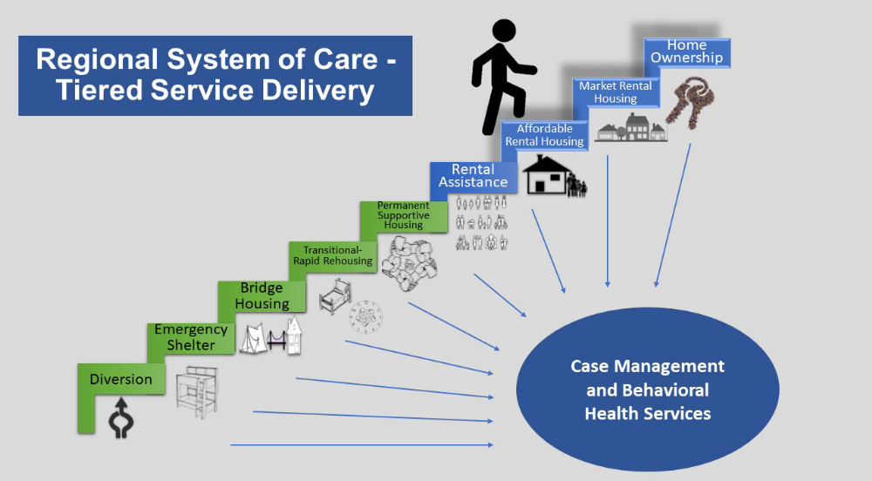

Slide 5
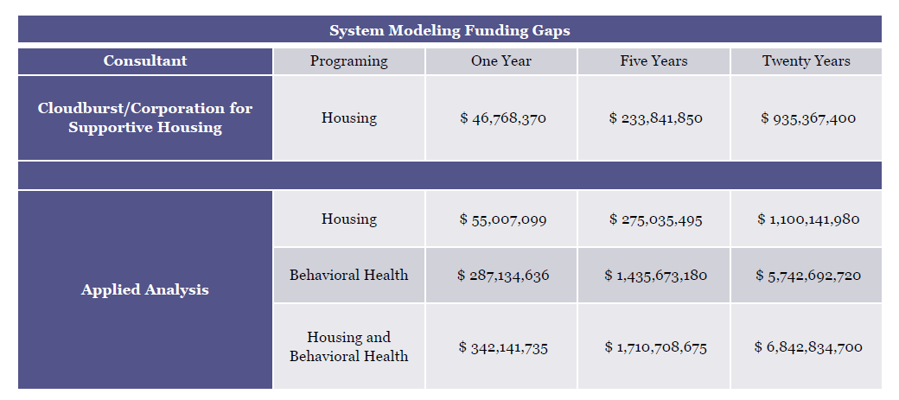
Funding Gaps in Current System
Two different analysis were performed independently of one another and both determined funding gaps in homeless housing services within a margin of $8 million in year one.
Notes:
The significant lack of available funding directly impacts Southern Nevada’s ability to successfully reduce and manage a growing homeless population. The Working Group engaged two (2) consulting firms to complete system modeling to identify funding gaps in homeless services. Applied Analysis provided an analysis of homelessness funding inclusive of both housing and behavioral health fiscal gaps and Cloudburst/Corporation for Supportive Housing, a HUD funded consultant, provided an analysis of funding for only housing fiscal gaps.

Slide 6
Working Group Recommendations
The Working Group identified six (6) categorical recommendations on methods to reduce homelessness:
Regional Oversight
Housing
Behavioral Health Services / Intensive Case Management
Coordination of Data
Prevention / Intervention
Affordable Housing Development Incentives
Notes:
The need to increase capacity across all levels of housing, inclusive of increased behavioral health, addiction, and case management programming, is estimated to be underfunded by $342 million annually.

Slide 7
Regional Oversight
Decision-making ability
Public and private partners
Housing
Largest resource needed to reduce homelessness
78,000 rental units needed
Behavioral Health Services / Intensive Case Management
79.9% of state Medicaid Behavioral Health dollars are spent in S. NV
Additional services and intensive case management needed
Plan and oversee regional efforts
Notes:
REGIONAL OVERSIGHT
To effectively address homelessness, a regional oversight body with decision making ability comprised of public and private entities is necessary to plan and oversee regional efforts, measure outcomes and efficiently maximize funding.
Recommendations:
Establish a Regional Homeless Coordinator to oversee a newly established regional oversight body to consist of local governments, service providers, and private sector entities.
The body will strategically coordinate, plan and implement programming and efforts to reduce homelessness and maximize collaborative solutions and funding through public private partnerships in the region.
Leverage private partners to assist with solutions and create public-private partnerships.
HOUSING
The lack of housing is the single largest resource needed to reduce homelessness. Southern Nevada currently has an estimated shortage of low-income affordable housing of over 78,000 rental units. This deficit, in conjunction with the increase in poverty, are the largest challenges to reduce homelessness.
Significant expansion of scattered site housing resources is needed at all levels, including basic shelter, transitional housing, permanent supportive housing, and affordable housing.
Recommendations:
Expand all levels of housing within the tiered service delivery system.Emergency shelter
Bridge housing
Transitional housing
Rapid-rehousing
Permanent supportive housing
Create incentives to retain and increase participation by property owners to become landlords to serve the homeless population, including master leasing.
Purchase vacant multi-unit properties in the region to establish additional non-congregate housing opportunities.
Expand affordable housing partnerships to increase capacity.
Increase shallow subsidies and housing vouchers to provide financial rental assistance for the very low-income population.
Expand case managers to locate clients and expedite placement.
Maintain affordability for housing through HUD and jurisdictional-sponsored programming to avoid a reduction in existing affordable housing inventory.
BEHAVIORAL HEALTH SERVICES / ICM
Access to behavioral health services and intensive case management are needed to successfully manage outcomes. Southern Nevada has a significant gap in both the availability of behavioral health services and intensive case managers to assist with high-need clients. Earlier behavioral health intervention can prevent more costly and acute service needs.
Though the behavioral health needs in the State are well known, they are particularly pronounced in Southern Nevada. In fact, the Department of Health and Human Services presented information to the Working Group that in 2019, a total of $244 million or 79.9% of the $306 million of all Medicaid Behavioral Health expenditures were spent in Southern Nevada.
Recommendations:
Maximize Medicaid reimbursement rates to attract more behavioral health professionals to Nevada.
Expand access and opportunities for behavioral health care and substance abuse treatment.
Consider a pilot program in partnership with the State and managed care organizations to provide for continued enrollment in managed care for targeted populations to maintain continuity of care.
Maximize state and federal reimbursement programming to support behavioral and medical case management (e.g., targeted case management, billing under a government agency for an increased rate as a Medicaid provider).

Slide 8
Coordination of Data
HUD compliant
Prevention / Intervention
Access services in a centralized coordinated manner earlier than before
Affordable Housing Development Incentives
Encourage building of affordable housing units and other projects
Collection, management, reporting standards
Oversight by SNH CoC
Ensure nobody falls through the cracks
Cost effective strategies
Advocate for changes to NRS to support certain incentives
Notes:
COORDINATION OF DATA
Nevada Continuum of Care (SNCoC) is responsible for the oversight of the system which complies with HUD’s data collection, management, and reporting standards across the spectrum of providers and entities delivering homeless services.
Recommendations:
Increase integration of local, state, and federal data to maximize service delivery and assistance.
Upgrade HMIS or implement a similar system to expand and improve functionality to track more complete data. Issues with the current system include, delays during busy client service periods and the inability perform uploads with files from outside of the system.
Expand HMIS to encourage more consistent use of the program, including standardized intake training, across all organizations that utilize the system, such as hospitals, correctional facilities, and homeless service providers.
Expand access to all service providers and other partners who work with the homeless, such as law enforcement.
PREVENTION / INTERVENTION
Prevention services allow individuals to access housing and other services in a centralized coordinated manner earlier than they may have been able to absent those interventions. Prevention and intervention prevent individuals from falling through the cracks requiring more expensive and intense interventions down the road, i.e., through the criminal justice system or emergency rooms.
Recommendations:
Fund diversion programs for one-time needs, such as a security deposit, to prevent individuals from entering the system.
Create “Housing Navigators” for landlord engagement and retention to prevent eviction.
Develop resource centers throughout Southern Nevada, including mobile outreach service centers throughout Southern Nevada to provide increased resource and service delivery.
Expand rental assistance, basic needs, and emergency assistance to prevent homelessness given current COVID-19 impacts over next 12-24 months.
AFFORDABLE HOUSING DEVELOPMENT INCENTIVES
Given the significant need for affordable housing inventory within the region, jurisdictions can provide a variety of incentives to developers to encourage the building of affordable housing units and other projects that meet community needs, provided changes to NRS are made to support certain incentives.
Utilize all public and private funding options to support flexible alternatives for the building and rehabilitation of affordable properties.
•Legislature to evaluate barriers to NRS to allow municipalities to not only establish but also finance housing/community land trusts to expand the number of affordable housing units, through development in-lieu and impact fees, land donations, and other financing methods.
•Jurisdictions should consider expediting permitting process and consider fee reductions for permits.
•Investment partnership to fill the gap traditionally filled by HUD and tax credit programs.
•Legislature to evaluate change in NRS that would allow municipalities to offer tax breaks or incentives to developers of new low-income housing units.
•Legislature to evaluate change in NRS that would allow municipalities to offer property owners tax breaks for providing very-low and low-income units to the region for emergency housing.

Slide 9
Regional Oversight
Decision-making ability
Public and private partners
Plan and oversee regional efforts
Establish a Regional Homeless Coordinator to oversee a newly established regional oversight body
Strategically coordinate, plan, and implement programming; maximize collaborative solutions and funding through public-private partnerships
Leverage private partners to assist with solutions and create public-private partnerships
Notes:
REGIONAL OVERSIGHT
To effectively address homelessness, a regional oversight body with decision making ability comprised of public and private entities is necessary to plan and oversee regional efforts, measure outcomes and efficiently maximize funding.
Recommendations:
Establish a Regional Homeless Coordinator to oversee a newly established regional oversight body to consist of local governments, service providers, and private sector entities.
The body will strategically coordinate, plan and implement programming and efforts to reduce homelessness and maximize collaborative solutions and funding through public private partnerships in the region.
Leverage private partners to assist with solutions and create public-private partnerships.
HOUSING
The lack of housing is the single largest resource needed to reduce homelessness. Southern Nevada currently has an estimated shortage of low-income affordable housing of over 78,000 rental units. This deficit, in conjunction with the increase in poverty, are the largest challenges to reduce homelessness.
Significant expansion of scattered site housing resources is needed at all levels, including basic shelter, transitional housing, permanent supportive housing, and affordable housing.
Recommendations:
Expand all levels of housing within the tiered service delivery system.Emergency shelter
Bridge housing
Transitional housing
Rapid-rehousing
Permanent supportive housing
Create incentives to retain and increase participation by property owners to become landlords to serve the homeless population, including master leasing.
Purchase vacant multi-unit properties in the region to establish additional non-congregate housing opportunities.
Expand affordable housing partnerships to increase capacity.
Increase shallow subsidies and housing vouchers to provide financial rental assistance for the very low-income population.
Expand case managers to locate clients and expedite placement.
Maintain affordability for housing through HUD and jurisdictional-sponsored programming to avoid a reduction in existing affordable housing inventory.
BEHAVIORAL HEALTH SERVICES / ICM
Access to behavioral health services and intensive case management are needed to successfully manage outcomes. Southern Nevada has a significant gap in both the availability of behavioral health services and intensive case managers to assist with high-need clients. Earlier behavioral health intervention can prevent more costly and acute service needs.
Though the behavioral health needs in the State are well known, they are particularly pronounced in Southern Nevada. In fact, the Department of Health and Human Services presented information to the Working Group that in 2019, a total of $244 million or 79.9% of the $306 million of all Medicaid Behavioral Health expenditures were spent in Southern Nevada.
Recommendations:
Maximize Medicaid reimbursement rates to attract more behavioral health professionals to Nevada.
Expand access and opportunities for behavioral health care and substance abuse treatment.
Consider a pilot program in partnership with the State and managed care organizations to provide for continued enrollment in managed care for targeted populations to maintain continuity of care.
Maximize state and federal reimbursement programming to support behavioral and medical case management (e.g., targeted case management, billing under a government agency for an increased rate as a Medicaid provider).

Slide 10
Housing
Largest resource needed to reduce homelessness
78,000 rental units needed
Expand all levels of housing within the tiered service delivery system
Create incentives to retain and increase property owner participation
Purchase vacant multi-unit properties for non-congregate housing options
Expand affordable housing partnerships and case management services
Increase shallow subsidies and housing vouchers
Maintain affordability for housing through HUD and jurisdictional sponsored programming
Notes:
REGIONAL OVERSIGHT
To effectively address homelessness, a regional oversight body with decision making ability comprised of public and private entities is necessary to plan and oversee regional efforts, measure outcomes and efficiently maximize funding.
Recommendations:
Establish a Regional Homeless Coordinator to oversee a newly established regional oversight body to consist of local governments, service providers, and private sector entities.
The body will strategically coordinate, plan and implement programming and efforts to reduce homelessness and maximize collaborative solutions and funding through public private partnerships in the region.
Leverage private partners to assist with solutions and create public-private partnerships.
HOUSING
The lack of housing is the single largest resource needed to reduce homelessness. Southern Nevada currently has an estimated shortage of low-income affordable housing of over 78,000 rental units. This deficit, in conjunction with the increase in poverty, are the largest challenges to reduce homelessness.
Significant expansion of scattered site housing resources is needed at all levels, including basic shelter, transitional housing, permanent supportive housing, and affordable housing.
Recommendations:
Expand all levels of housing within the tiered service delivery system.Emergency shelter
Bridge housing
Transitional housing
Rapid-rehousing
Permanent supportive housing
Create incentives to retain and increase participation by property owners to become landlords to serve the homeless population, including master leasing.
Purchase vacant multi-unit properties in the region to establish additional non-congregate housing opportunities.
Expand affordable housing partnerships to increase capacity.
Increase shallow subsidies and housing vouchers to provide financial rental assistance for the very low-income population.
Expand case managers to locate clients and expedite placement.
Maintain affordability for housing through HUD and jurisdictional-sponsored programming to avoid a reduction in existing affordable housing inventory.
BEHAVIORAL HEALTH SERVICES / ICM
Access to behavioral health services and intensive case management are needed to successfully manage outcomes. Southern Nevada has a significant gap in both the availability of behavioral health services and intensive case managers to assist with high-need clients. Earlier behavioral health intervention can prevent more costly and acute service needs.
Though the behavioral health needs in the State are well known, they are particularly pronounced in Southern Nevada. In fact, the Department of Health and Human Services presented information to the Working Group that in 2019, a total of $244 million or 79.9% of the $306 million of all Medicaid Behavioral Health expenditures were spent in Southern Nevada.
Recommendations:
Maximize Medicaid reimbursement rates to attract more behavioral health professionals to Nevada.
Expand access and opportunities for behavioral health care and substance abuse treatment.
Consider a pilot program in partnership with the State and managed care organizations to provide for continued enrollment in managed care for targeted populations to maintain continuity of care.
Maximize state and federal reimbursement programming to support behavioral and medical case management (e.g., targeted case management, billing under a government agency for an increased rate as a Medicaid provider).

Slide 11
Behavioral Health Services / Intensive Case Management
79.9% of state Medicaid Behavioral Health dollars are spent in S. NV
Additional services and intensive case management needed
Maximize Medicaid reimbursement rates to attract more behavioral health professionals
Expand access and opportunities for behavioral health care and substance abuse treatment
Consider a pilot program with State and manage care organizations to maintain continuity of care
Maximize state and federal reimbursement programming to support behavioral and medical case management
Notes:
REGIONAL OVERSIGHT
To effectively address homelessness, a regional oversight body with decision making ability comprised of public and private entities is necessary to plan and oversee regional efforts, measure outcomes and efficiently maximize funding.
Recommendations:
Establish a Regional Homeless Coordinator to oversee a newly established regional oversight body to consist of local governments, service providers, and private sector entities.
The body will strategically coordinate, plan and implement programming and efforts to reduce homelessness and maximize collaborative solutions and funding through public private partnerships in the region.
Leverage private partners to assist with solutions and create public-private partnerships.
HOUSING
The lack of housing is the single largest resource needed to reduce homelessness. Southern Nevada currently has an estimated shortage of low-income affordable housing of over 78,000 rental units. This deficit, in conjunction with the increase in poverty, are the largest challenges to reduce homelessness.
Significant expansion of scattered site housing resources is needed at all levels, including basic shelter, transitional housing, permanent supportive housing, and affordable housing.
Recommendations:
Expand all levels of housing within the tiered service delivery system.Emergency shelter
Bridge housing
Transitional housing
Rapid-rehousing
Permanent supportive housing
Create incentives to retain and increase participation by property owners to become landlords to serve the homeless population, including master leasing.
Purchase vacant multi-unit properties in the region to establish additional non-congregate housing opportunities.
Expand affordable housing partnerships to increase capacity.
Increase shallow subsidies and housing vouchers to provide financial rental assistance for the very low-income population.
Expand case managers to locate clients and expedite placement.
Maintain affordability for housing through HUD and jurisdictional-sponsored programming to avoid a reduction in existing affordable housing inventory.
BEHAVIORAL HEALTH SERVICES / ICM
Access to behavioral health services and intensive case management are needed to successfully manage outcomes. Southern Nevada has a significant gap in both the availability of behavioral health services and intensive case managers to assist with high-need clients. Earlier behavioral health intervention can prevent more costly and acute service needs.
Though the behavioral health needs in the State are well known, they are particularly pronounced in Southern Nevada. In fact, the Department of Health and Human Services presented information to the Working Group that in 2019, a total of $244 million or 79.9% of the $306 million of all Medicaid Behavioral Health expenditures were spent in Southern Nevada.
Recommendations:
Maximize Medicaid reimbursement rates to attract more behavioral health professionals to Nevada.
Expand access and opportunities for behavioral health care and substance abuse treatment.
Consider a pilot program in partnership with the State and managed care organizations to provide for continued enrollment in managed care for targeted populations to maintain continuity of care.
Maximize state and federal reimbursement programming to support behavioral and medical case management (e.g., targeted case management, billing under a government agency for an increased rate as a Medicaid provider).

Slide 12
Coordination of Data
HUD compliant
Collection, management, reporting standards
Oversight by SNH CoC
Increase integration of local, state, and federal data to maximize service delivery and assistance.
Upgrade HMIS or similar system to expand and improve functionality to track more complete data
Expand HMIS for more consistent use of the program across all organizations that utilize the system
Expand access to all service providers and other partners in sectors that engage individuals experiencing homelessness
Notes:
COORDINATION OF DATA
Nevada Continuum of Care (SNH CoC) is responsible for the oversight of the system which complies with HUD’s data collection, management, and reporting standards across the spectrum of providers and entities delivering homeless services.
Recommendations:
Increase integration of local, state, and federal data to maximize service delivery and assistance.
Upgrade HMIS or implement a similar system to expand and improve functionality to track more complete data. Issues with the current system include, delays during busy client service periods and the inability perform uploads with files from outside of the system.
Expand HMIS to encourage more consistent use of the program, including standardized intake training, across all organizations that utilize the system, such as hospitals, correctional facilities, and homeless service providers.
Expand access to all service providers and other partners who work with the homeless, such as law enforcement.
PREVENTION / INTERVENTION
Prevention services allow individuals to access housing and other services in a centralized coordinated manner earlier than they may have been able to absent those interventions. Prevention and intervention prevent individuals from falling through the cracks requiring more expensive and intense interventions down the road, i.e., through the criminal justice system or emergency rooms.
Recommendations:
Fund diversion programs for one-time needs, such as a security deposit, to prevent individuals from entering the system.
Create “Housing Navigators” for landlord engagement and retention to prevent eviction.
Develop resource centers throughout Southern Nevada, including mobile outreach service centers throughout Southern Nevada to provide increased resource and service delivery.
Expand rental assistance, basic needs, and emergency assistance to prevent homelessness given current COVID-19 impacts over next 12-24 months.
AFFORDABLE HOUSING DEVELOPMENT INCENTIVES
Given the significant need for affordable housing inventory within the region, jurisdictions can provide a variety of incentives to developers to encourage the building of affordable housing units and other projects that meet community needs, provided changes to NRS are made to support certain incentives.
Utilize all public and private funding options to support flexible alternatives for the building and rehabilitation of affordable properties.
•Legislature to evaluate barriers to NRS to allow municipalities to not only establish but also finance housing/community land trusts to expand the number of affordable housing units, through development in-lieu and impact fees, land donations, and other financing methods.
•Jurisdictions should consider expediting permitting process and consider fee reductions for permits.
•Investment partnership to fill the gap traditionally filled by HUD and tax credit programs.
•Legislature to evaluate change in NRS that would allow municipalities to offer tax breaks or incentives to developers of new low-income housing units.
•Legislature to evaluate change in NRS that would allow municipalities to offer property owners tax breaks for providing very-low and low-income units to the region for emergency housing.

Slide 13
Prevention / Intervention
Access services in a centralized coordinated manner earlier than before
Ensure nobody falls through the cracks
Cost effective strategies
Fund diversion programs for one-time needs
Create “Housing Navigators” for landlord engagement and retention and to prevent evictions
Develop resource centers and mobile outreach service centers to increase resource and service delivery
Expand rental assistance, basic needs, and emergency assistance to prevent homelessness given COVID-19 impacts
Notes:
COORDINATION OF DATA
Nevada Continuum of Care (SNCoC) is responsible for the oversight of the system which complies with HUD’s data collection, management, and reporting standards across the spectrum of providers and entities delivering homeless services.
Recommendations:
Increase integration of local, state, and federal data to maximize service delivery and assistance.
Upgrade HMIS or implement a similar system to expand and improve functionality to track more complete data. Issues with the current system include, delays during busy client service periods and the inability perform uploads with files from outside of the system.
Expand HMIS to encourage more consistent use of the program, including standardized intake training, across all organizations that utilize the system, such as hospitals, correctional facilities, and homeless service providers.
Expand access to all service providers and other partners who work with the homeless, such as law enforcement.
PREVENTION / INTERVENTION
Prevention services allow individuals to access housing and other services in a centralized coordinated manner earlier than they may have been able to absent those interventions. Prevention and intervention prevent individuals from falling through the cracks requiring more expensive and intense interventions down the road, i.e., through the criminal justice system or emergency rooms.
Recommendations:
Fund diversion programs for one-time needs, such as a security deposit, to prevent individuals from entering the system.
Create “Housing Navigators” for landlord engagement and retention to prevent eviction.
Develop resource centers throughout Southern Nevada, including mobile outreach service centers throughout Southern Nevada to provide increased resource and service delivery.
Expand rental assistance, basic needs, and emergency assistance to prevent homelessness given current COVID-19 impacts over next 12-24 months.
AFFORDABLE HOUSING DEVELOPMENT INCENTIVES
Given the significant need for affordable housing inventory within the region, jurisdictions can provide a variety of incentives to developers to encourage the building of affordable housing units and other projects that meet community needs, provided changes to NRS are made to support certain incentives.
Utilize all public and private funding options to support flexible alternatives for the building and rehabilitation of affordable properties.
•Legislature to evaluate barriers to NRS to allow municipalities to not only establish but also finance housing/community land trusts to expand the number of affordable housing units, through development in-lieu and impact fees, land donations, and other financing methods.
•Jurisdictions should consider expediting permitting process and consider fee reductions for permits.
•Investment partnership to fill the gap traditionally filled by HUD and tax credit programs.
•Legislature to evaluate change in NRS that would allow municipalities to offer tax breaks or incentives to developers of new low-income housing units.
•Legislature to evaluate change in NRS that would allow municipalities to offer property owners tax breaks for providing very-low and low-income units to the region for emergency housing.

Slide 14
Affordable Housing Development Incentives
Encourage building of affordable housing units and other projects
Advocate for changes to NRS to support certain incentives
Utilize public and private funding options to support flexible alternatives for building and rehabilitation of affordable properties
Legislature to evaluate barriers to NRS to allow municipalities to establish and finance housing units, offer tax breaks or incentives, and/or offer property owners tax breaks for providing very-low and low-income units for emergency housing
Jurisdictions to consider expediting permitting process and fee reductions
Investment partnership to fill gaps
Notes:
COORDINATION OF DATA
Nevada Continuum of Care (SNCoC) is responsible for the oversight of the system which complies with HUD’s data collection, management, and reporting standards across the spectrum of providers and entities delivering homeless services.
Recommendations:
Increase integration of local, state, and federal data to maximize service delivery and assistance.
Upgrade HMIS or implement a similar system to expand and improve functionality to track more complete data. Issues with the current system include, delays during busy client service periods and the inability perform uploads with files from outside of the system.
Expand HMIS to encourage more consistent use of the program, including standardized intake training, across all organizations that utilize the system, such as hospitals, correctional facilities, and homeless service providers.
Expand access to all service providers and other partners who work with the homeless, such as law enforcement.
PREVENTION / INTERVENTION
Prevention services allow individuals to access housing and other services in a centralized coordinated manner earlier than they may have been able to absent those interventions. Prevention and intervention prevent individuals from falling through the cracks requiring more expensive and intense interventions down the road, i.e., through the criminal justice system or emergency rooms.
Recommendations:
Fund diversion programs for one-time needs, such as a security deposit, to prevent individuals from entering the system.
Create “Housing Navigators” for landlord engagement and retention to prevent eviction.
Develop resource centers throughout Southern Nevada, including mobile outreach service centers throughout Southern Nevada to provide increased resource and service delivery.
Expand rental assistance, basic needs, and emergency assistance to prevent homelessness given current COVID-19 impacts over next 12-24 months.
AFFORDABLE HOUSING DEVELOPMENT INCENTIVES
Given the significant need for affordable housing inventory within the region, jurisdictions can provide a variety of incentives to developers to encourage the building of affordable housing units and other projects that meet community needs, provided changes to NRS are made to support certain incentives.
Utilize all public and private funding options to support flexible alternatives for the building and rehabilitation of affordable properties.
•Legislature to evaluate barriers to NRS to allow municipalities to not only establish but also finance housing/community land trusts to expand the number of affordable housing units, through development in-lieu and impact fees, land donations, and other financing methods.
•Jurisdictions should consider expediting permitting process and consider fee reductions for permits.
•Investment partnership to fill the gap traditionally filled by HUD and tax credit programs.
•Legislature to evaluate change in NRS that would allow municipalities to offer tax breaks or incentives to developers of new low-income housing units.
•Legislature to evaluate change in NRS that would allow municipalities to offer property owners tax breaks for providing very-low and low-income units to the region for emergency housing.

Slide 15
Potential Sources of Funding Identified to Reduce Homelessness
Legislative action
Build provider capacity
Maximize funding
Tax or fees on new developments
Tax or fees on sporting events
Notes:
The Working Group recognizes that limited options exist for expanded funding. The following recommendations were offered:
Maximize federal, state and local funding to build provider capacity.
Legislative action to establish enabling language to support local government funding opportunities to support programming and services to reduce homelessness.
Legislative action to identify a dedicated tax source to fund homelessness.
Impose a tax or fee on new housing developments/construction similar to the Residential Construction Tax.
Impose a tax or fee on professional sporting events.

Slide 16
Report of the Working Group to Address Homelessness
Assembly Bill 73
QUESTIONS?

