Slide 1
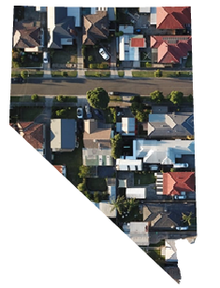

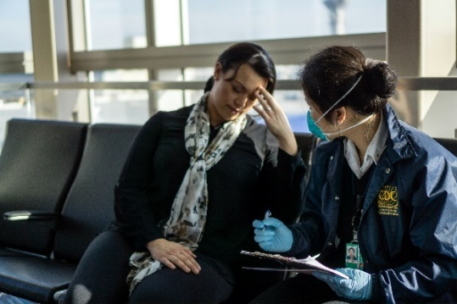

The Impacts of COVID-19 and Eviction Risk in Nevada
September 2020
Nancy Brune, Ph.D.
Executive Director

Slide 2
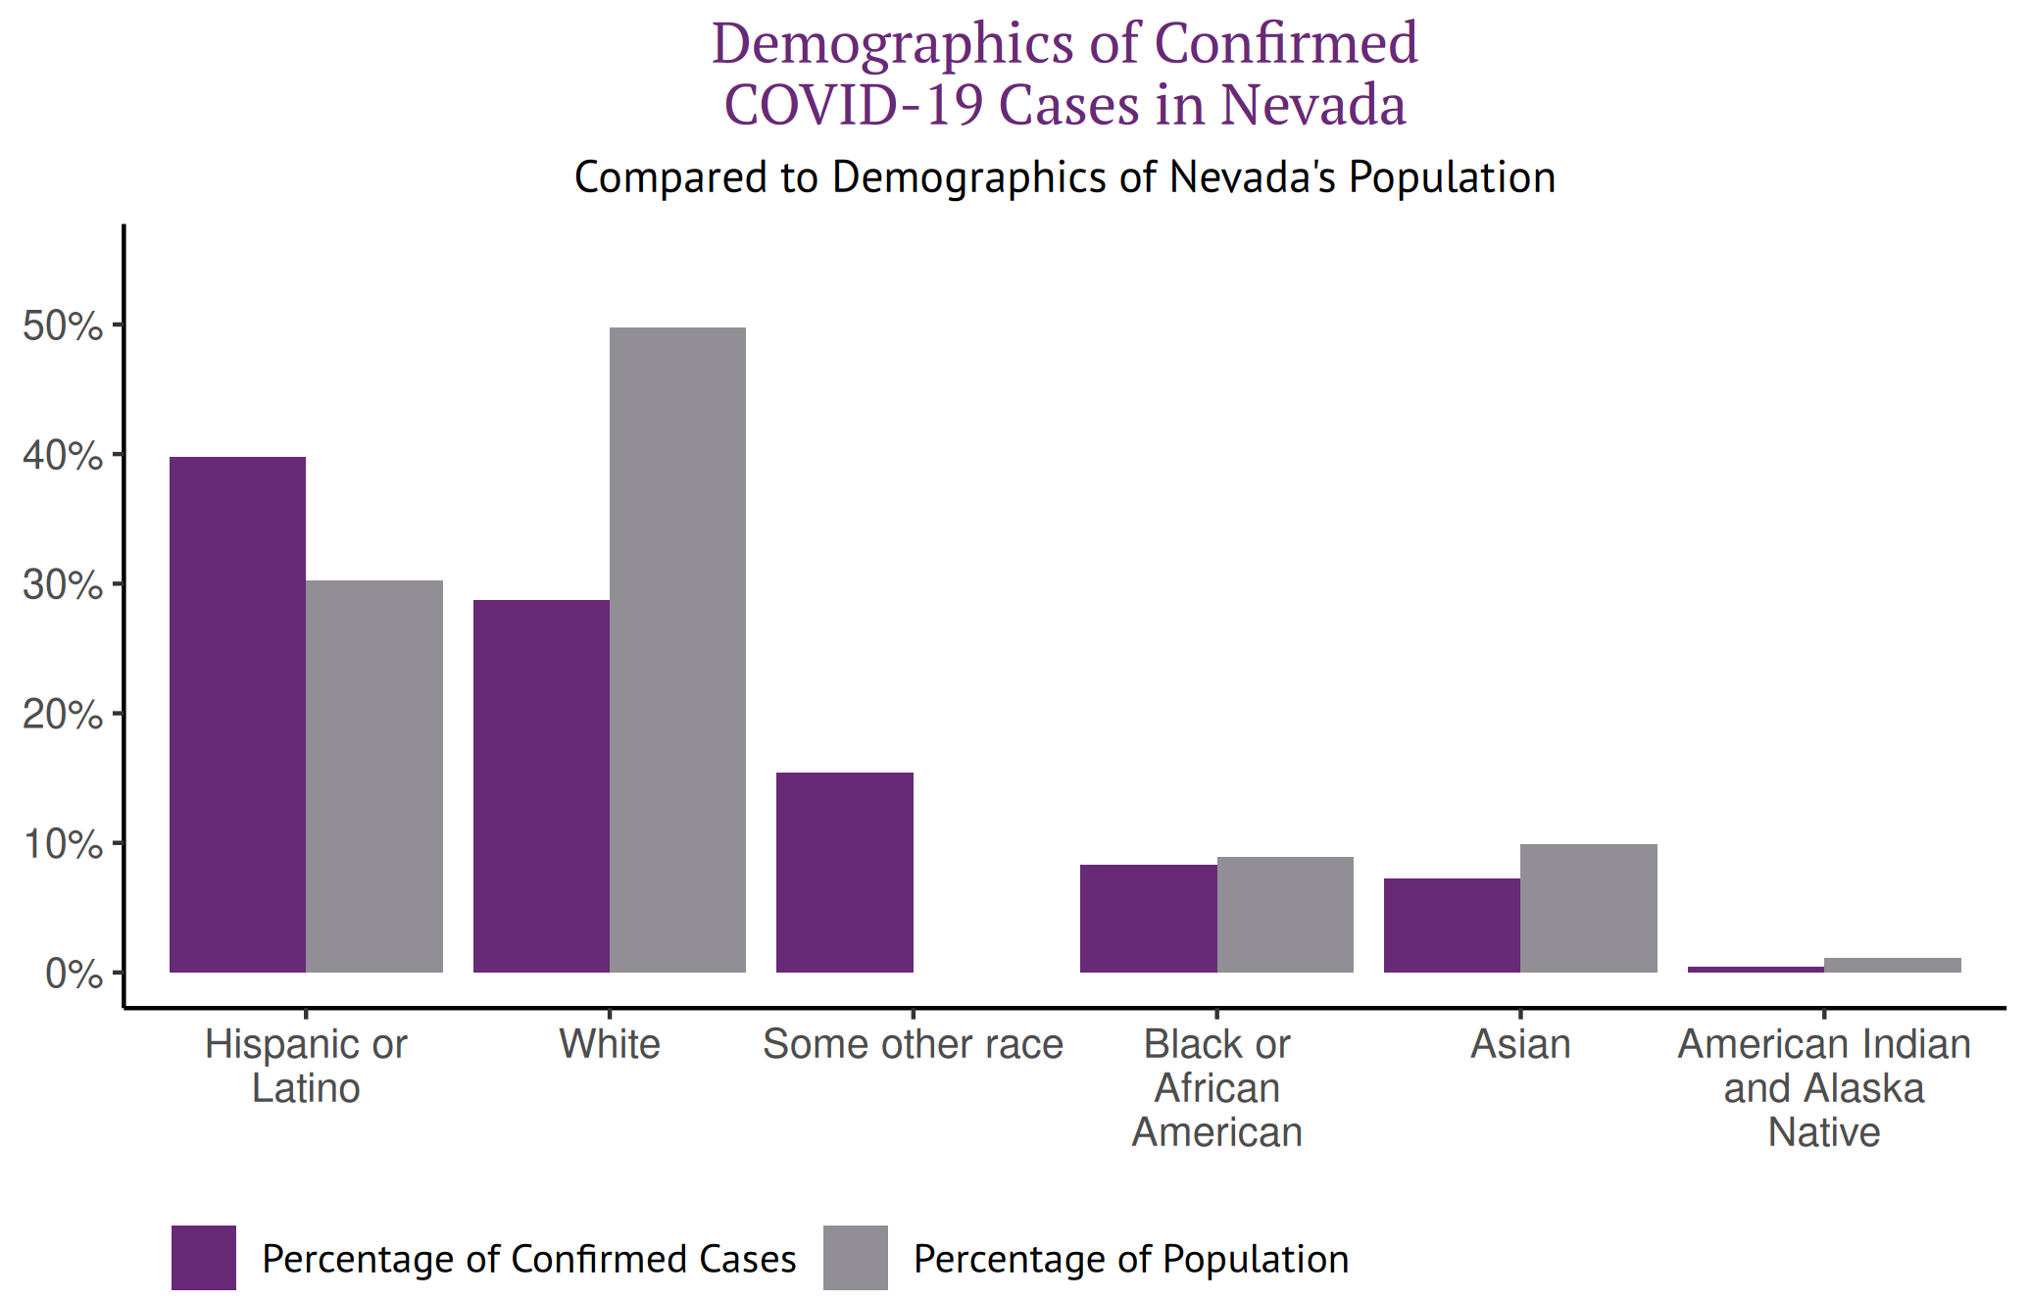
COVID-19 has disproportionately affected Communities of Color
Latinos in Nevada Account for a Greater Share of Confirmed COVID-19 Cases
Notes:
First we found that Latinos in Nevada account for a greater share of COVID-19 cases.
As of August 25, 2020, there have been 66,666 confirmed COVID-19 cases in Nevada.
The incidence rate of COVID-19 varies across racial and ethnic groups in Nevada.
Non-Latino whites represent roughly 50.0 percent of Nevada’s population. However, they account for 28.8 percent of Nevada’s confirmed COVID-19 cases.
Asians comprise 9.9 percent of the population and account for 7.2 percent of cases. African Americans represent 8.9 percent of the population and account for 8.3 percent of COVID-19 cases. Latinos in Nevada represent 30.3 percent of the state’s
population and account for 39.8 percent of cases.
American Indians/Alaska Natives (AI/AN) comprise 1.1 percent of Nevada’s population and represent only 0.5 percent of COVID-19 cases.
While the number of COVID-19 cases among Nevada’s American Indian/Alaska Native communities appears low, it has been reported that “tribal case counts don’t seem to be reflected in state tallies.” NEXT SLIDE please.

Slide 3
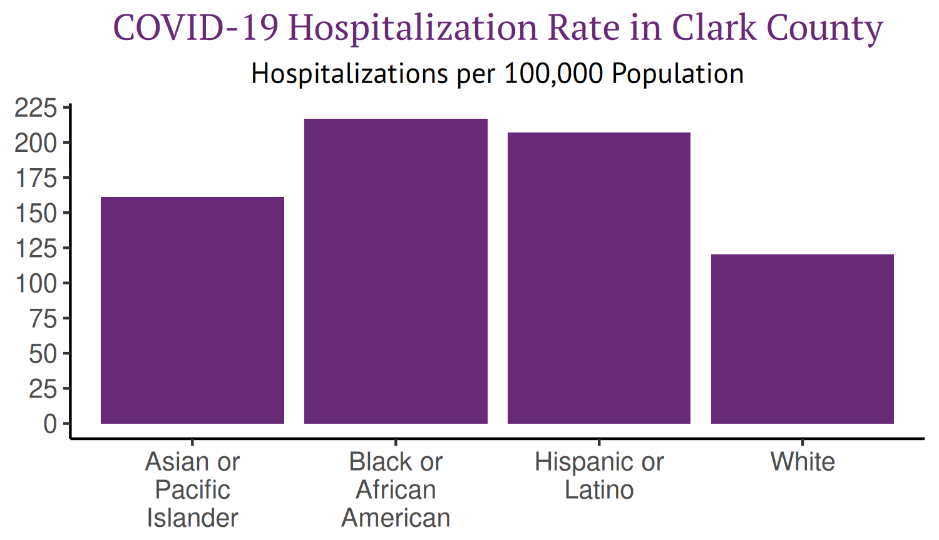
COVID-19 has disproportionately affected Communities of Color
African Americans Have the Highest Hospitalization Rate in Clark County
Notes:
We also found that African Americans Have the Highest COVID-19 related Hospitalization rate in Clark County.
Statewide hospitalization rate data are not available for Nevada, only for Clark County.
As shown in this figure, whites in Nevada have the lowest hospitalization rate, at 120.2 hospitalizations per 100,000 population. In contrast, African Americans have the highest hospitalization rate, at 216.9 hospitalizations per 100,000 population, nearly double the rate of whites. Next slide please
The hospitalization rate for Latinos is 207.2 per 100,000 population followed by Asian and Pacific Islanders at 161.2 hospitalizations per 100,000 population, respectively.

Slide 4
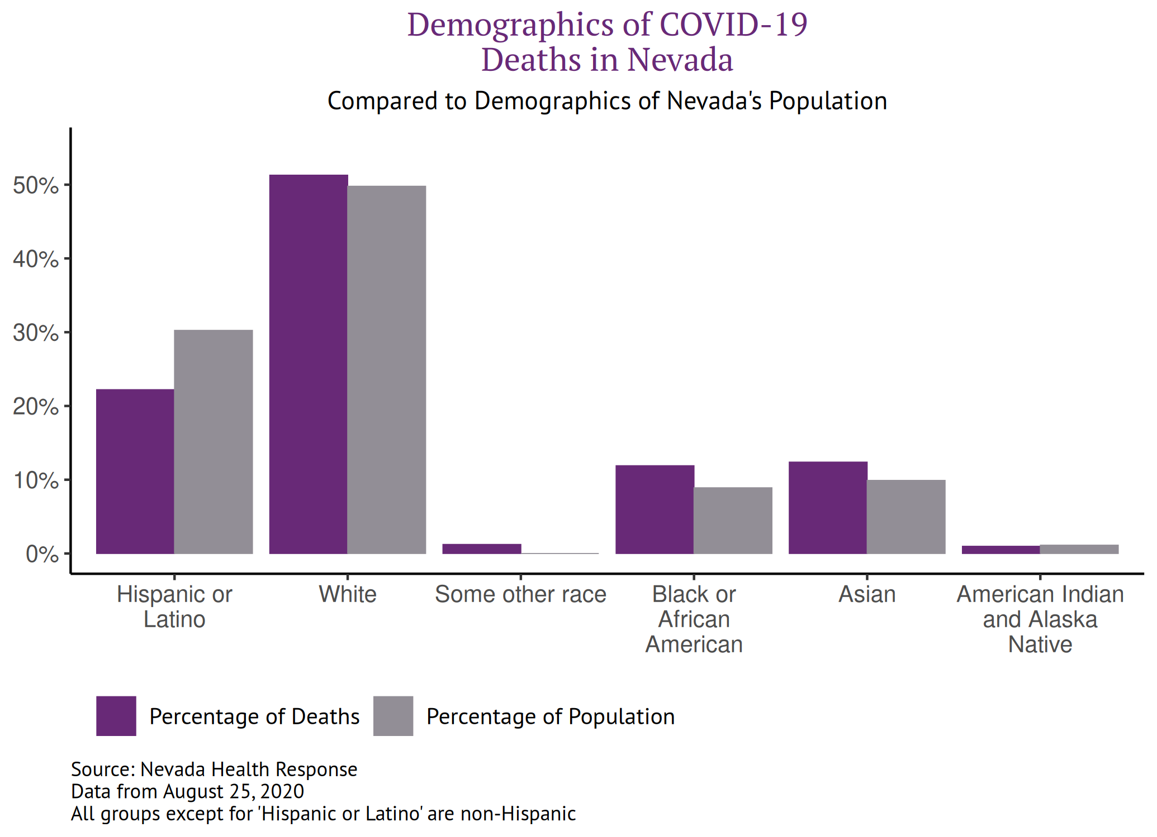
COVID-19 has disproportionately affected Communities of Color
COVID-19 Mortality Rates Are High Among Asian Americans and African Americans Relative to Their Share of the Population
Notes:
Finally, we found that COVID-19 mortality rates are high among Asian Americans and African Americans relative to their share of the population.
The demographic distribution of COVID-19 deaths also varies by race and ethnicity. As of August 25, 2020, there have been 1,250 COVID-19 deaths in Nevada.
As this figure illustrates, Asians account for 12.4 percent of deaths but only represent 9.9 percent of Nevada’s population, and African Americans account for 11.9 percent of deaths but only 8.9 percent of the population. Whites account for 51.3 percent of deaths, which is roughly equivalent to their representation in the population.
So, as we look at the impact of COVID-19 on communities of color and start to puzzle about the Why – we began to look at the underlying health conditions among our racial and ethnic groups here in Nevada.
The Centers for Disease Control and Prevention (CDC) reported that age, diabetes, heart disease, and lung diseases are among the most significant risk factors for severe COVID-19-related illness.
The prevalence of these conditions among different racial and ethnic groups varies: NEXT SLIDE PLEASE
Latinos, which represent 30 % of Nevada’s population, account for 22.2% of deaths. American Indians represent 1.1% of Nevada’s population and account for 0.9% of COVID-19 deaths.-

Slide 5
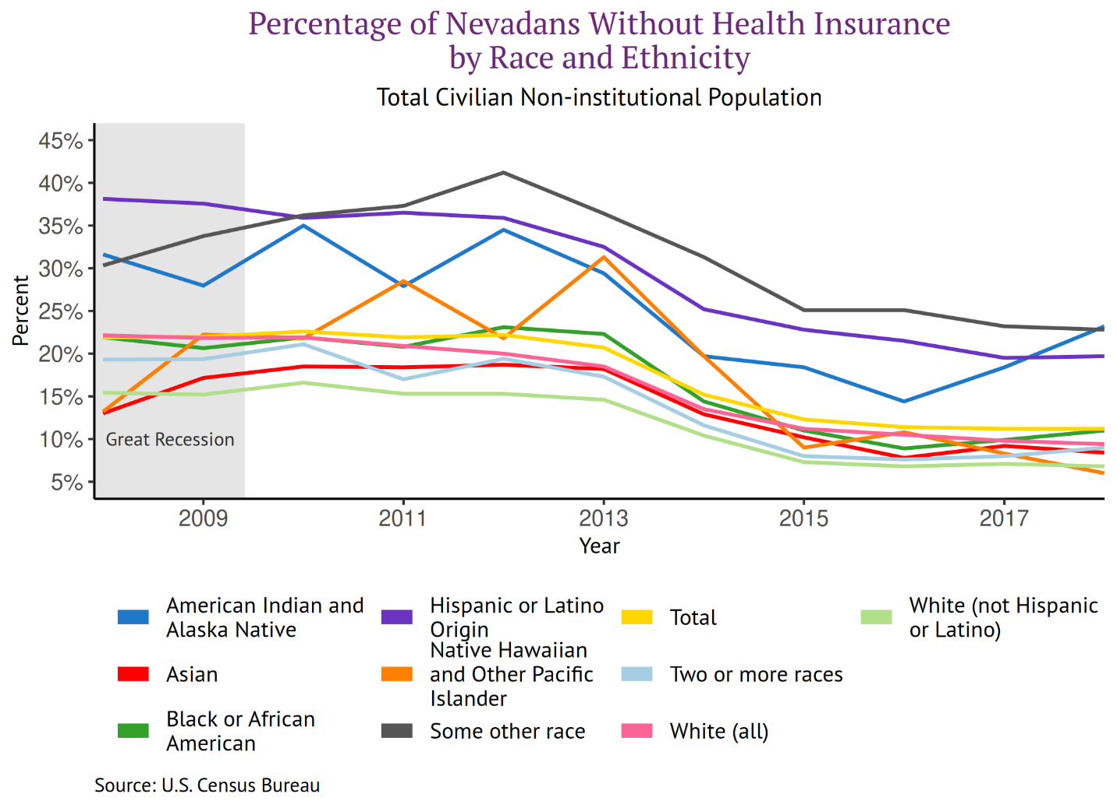
Underlying Health Issues and Health Care Access Factors Make Communities of Color More Vulnerable
A Large Proportion of American Indians and Latinos in Nevada Lack Health Insurance
272,00-327,00
1,260,000
990,000
Notes:
While risk factors vary in prevalence among different racial and ethnic groups, people of color tend to have more limited access to health care. These underlying health conditions and differences in
access to health care may contribute to the higher rates of COVID-19 incidence, hospitalizations, and mortality among diverse racial and ethnic groups compared to whites.
The number of Nevadans without health insurance has declined in recent years, largely due to Nevada’s decision in 2015 to expand Medicaid. However, despite these efforts, Nevada’s uninsurance rate was the seventh-highest in the nation in 2019. Roughly 338,700 Nevadans, or 11.0 percent of the population, lack health insurance, compared to the national rate of 9.0 percent. As this figure shows, while the overall uninsurance rate has declined, there are marked disparities in uninsurance rates across racial groups. Whites, Asians and individuals identifying as biracial/multiracial have the lowest uninsurance rates at roughly 9.0%. In contrast, American Indians/Alaska Natives and individuals identifying as Other Race have uninsurance rates greater than 22 %, followed by Latinos at 20 %, and African Americans at 11 %.

Slide 6
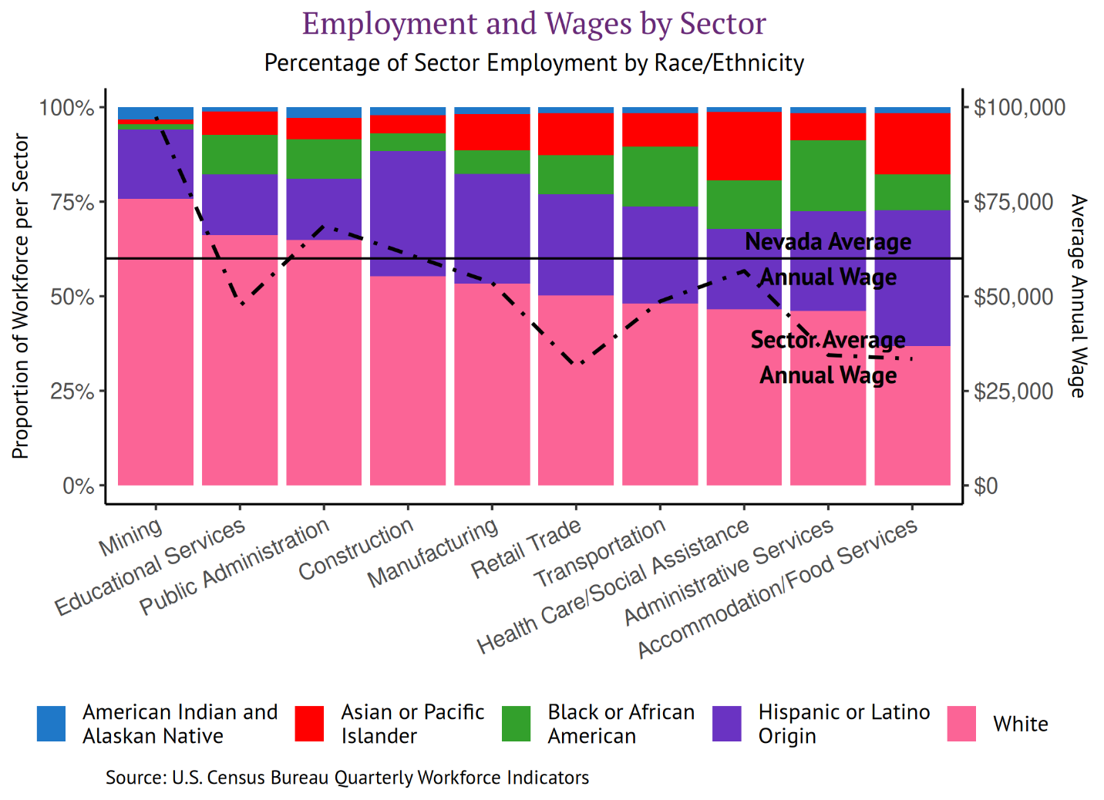
Economic Impacts of COVID-19 Have Affected Communities of Color
People of Color Are Overrepresented in Low-Wage Sectors
272,00-327,00
1,260,000
990,000
Notes:
People of color account for roughly half of all employment in the retail trade,
transportation, health care and social assistance, administrative, support and waste management services, and accommodation and food services sectors. Specifically, people of color account for almost two-thirds of all employment in the accommodation and food services sector, more than half of employment in administrative, support and waste management services, and exactly half in retail. Average wages in these three sectors are at least $20,000 lower than the average wage across all sectors in Nevada. The average wage in the sectors that employ significant people of color is often lower than the state average wage.

Slide 7
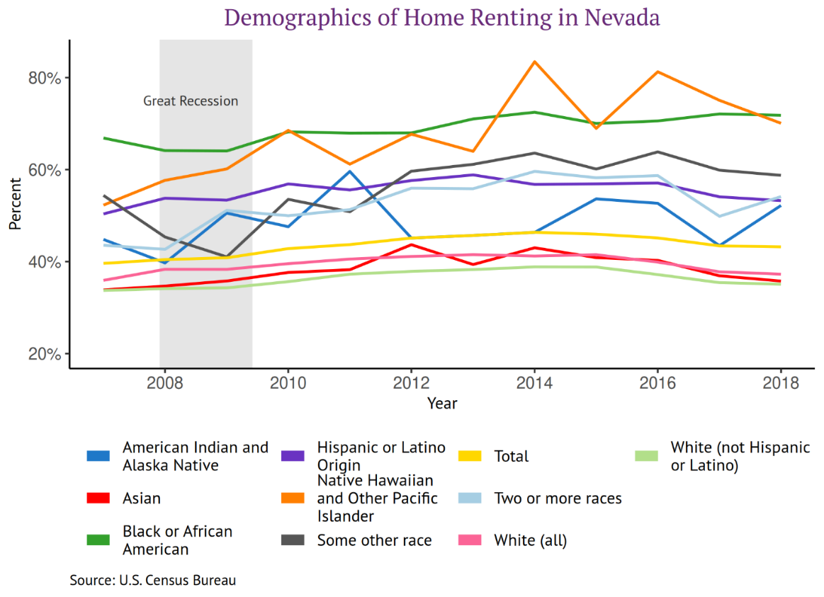
Economic Impacts of COVID-19 Have Affected Communities of Color
Most African Americans and Native Hawaiians/Pacific Islanders in Nevada Rent Their Homes
272,00-327,00
1,260,000
990,000
Notes:
People of color account for roughly half of all employment in the retail trade,
transportation, health care and social assistance, administrative, support and waste management services, and accommodation and food services sectors. Specifically, people of color account for almost two-thirds of all employment in the accommodation and food services sector, more than half of employment in administrative, support and waste management services, and exactly half in retail. Average wages in these three sectors are at least $20,000 lower than the average wage across all sectors in Nevada. The average wage in the sectors that employ significant people of color is often lower than the state average wage.

Slide 8
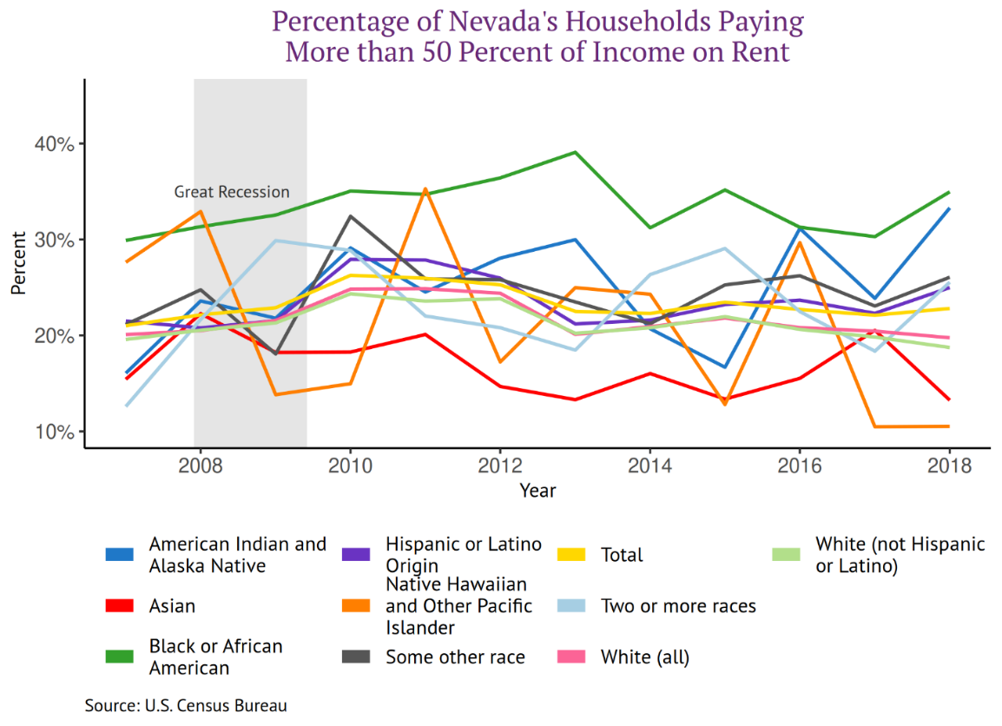
Economic Impacts of COVID-19 Have Affected Communities of Color
People of Color in Nevada Pay More than Half of Their Incomes on Rent
272,00-327,00
1,260,000
990,000
Notes:
People of color account for roughly half of all employment in the retail trade,
transportation, health care and social assistance, administrative, support and waste management services, and accommodation and food services sectors. Specifically, people of color account for almost two-thirds of all employment in the accommodation and food services sector, more than half of employment in administrative, support and waste management services, and exactly half in retail. Average wages in these three sectors are at least $20,000 lower than the average wage across all sectors in Nevada. The average wage in the sectors that employ significant people of color is often lower than the state average wage.

Slide 9
Between 272,000-327,000 Nevadans (or 118,000-142,000 households) could struggle to pay their rent by September 2020
Nevada Tenants Eviction Risk by Sept 2020
# of people in rented housing at risk of eviction
Low-income individuals, people of color, and undocumented individuals are especially vulnerable to housing market disruptions
272,000-327,000
1,260,000
990,000
Tenants with limited / no eviction risk
Tenants at risk of eviction through Q3 2020
Total NV tenant population
Source: COVID-19 Eviction Defense Project (CEDP) Model, 6/5/2020. See Methodology Page for Details.

Slide 10
The COVID-19 eviction crisis will have 3 phases; of the ~300K Nevadans at risk of eviction, people of color, low-income & undocumented renters are most vulnerable
Nevada Tenants Eviction Risk (2020)
# People
38% Renter Unemployment
32% Renters Unemployed
Vulnerable When Savings & Credit Run Out
Vulnerable Once Enhanced UI Expires
Vulnerable Once Moratorium Expires
Apr ’20
May ’20
Jun ’20
Jul ’20
Aug ’20
Sep ’20
Oct ’20
Nov ’20
Dec ’20
At Risk Groups
Non-Citizens
Citizens unable to access unemployment insurance (UI) & stimulus without savings
African American & Latino/a Communities
Middle- and moderate-income individuals & families with high rental cost burdens
African American & Latino/a communities
Lower-income citizens w/ low savings
Middle-income families paying high-rents with savings or access to credit
Families with low savings or access to credit
Families with savings and access to credit after enhanced UI expires
Lower-middle income families that saved UI and stimulus above typical income
Multi-income families

Slide 11
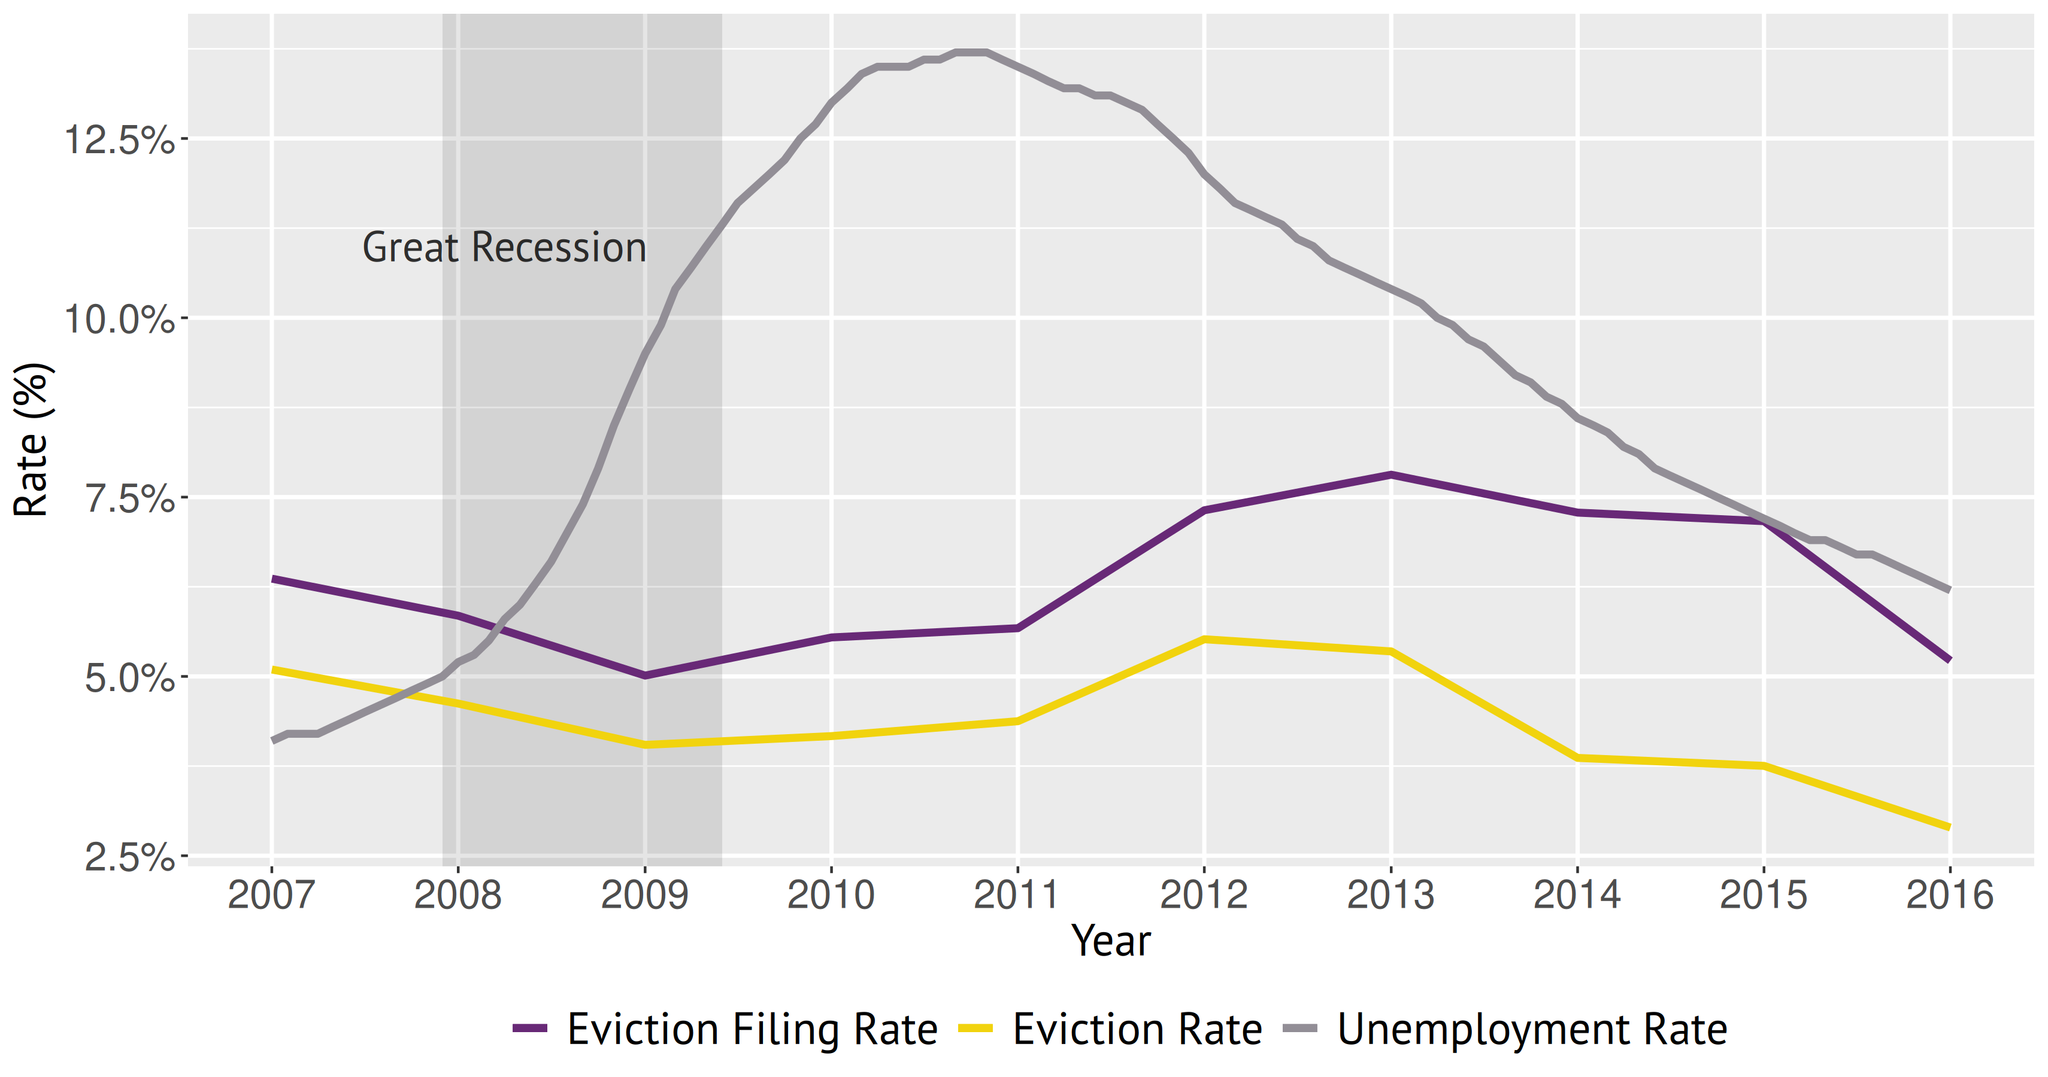
Historical data reveals evictions increased in Nevada as unemployment declined, and the economy began to recover
Source: Guinn Center calculations, using data from EvictionLab.org and U.S. Bureau of Labor Statistics

Slide 12
Policymakers should consider the following policy options
Short-term action
Provide free testing and treatment for affected workers
Expand access to (free) testing
Provide free treatment to dislocated workers and/or frontline industry workers
1
Increase funding for rental assistance programs
Direct additional CARES funds to state/county rental assistance programs
2
Expand access to short-term training courses
Ensure that cuts to higher education do not compromise accelerated training progams (such as CSN’s Rapid Response/RE-HIRE Centers, etc.)
3
Support federal legislation that provides housing assistance
Support federal legislation that provides housing assistance
4

Slide 13
Contact
About the Guinn Center
The Guinn Center is a 501(c)(3) nonprofit, nonpartisan, independent research center that seeks to identify evidence-based solutions through research, public engagement, and strategic partnerships.
Contact information:
Nancy Brune, Ph.D., Executive Director
Guinn Center
P.O. Box 750117
Las Vegas, Nevada 89136
Phone: 702-457-7509
Email: info@guinncenter.org

