Slide 1

Southern Nevada Homelessness Continuum of Care Youth Action Board
Notes:
Intro

Slide 2

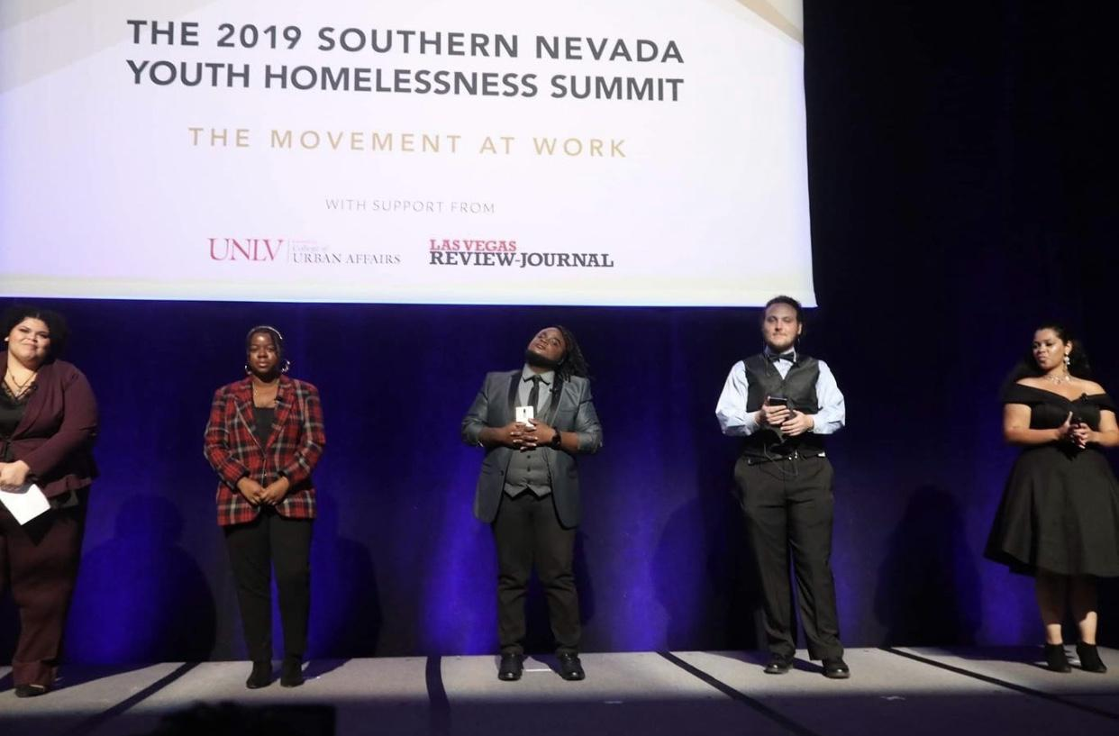
YAC Mission Statement:
“To eradicate youth homelessness by
empowering youth voice via advocacy.”
YAC Vision Statement:
“That youth experiencing homelessness
have opportunities to become
self-sufficient, be heard, and positively contribute to society.”
Notes:
-Parameters of YAC (age requirement, youth with lived experiences of homelessness, a leadership group within the Southern Nevada Homelessness Continuum of Care)

Slide 3
Homeless Definitions
 | McKinney-Vento (Department of Ed.) & Health and Human Services | Housing and Urban Development (HUD)
Shelters | ✔ | ✔
Doubled Up/Couch Surfing | ✔
Hotel/Motel | ✔
Unsheltered | ✔ | ✔
Notes:
How funding is affected, how youth experience homelessness, how is it different from other subgroups experiencing homelessness? Does Allison have responses from ice breaker on this?
Department of Ed Data
National picture?
https://www.schoolhouseconnection.org/
https://www.chapinhall.org/project/voices-of-youth-count/

Slide 4
Data
On any given night in Southern Nevada, there are approximately 979 unsheltered unaccompanied youth and children
Between Emergency Shelter and Permanent Housing there are only 218 beds available satisfying only about 22% of need (2019 Annual Homeless Assessment & HIC Report)
For every 10 youth experiencing homelessness, less than 3 would get a bed.
Notes:
https://files.hudexchange.info/resources/documents/2019-AHAR-Part-1.pdf (Gives information about the numbers of youth homelessness via each state and CoCs).
https://files.hudexchange.info/reports/published/CoC_HIC_State_NV_2019.pdf (Provides data about the number of beds available in the state and the Las Vegas/Clark County CoC that are available for homeless youth). *You can compare the AHAR to the HIC to estimate a percentage of the need our community has…)
https://voicesofyouthcount.org/wp-content/uploads/2017/11/ChapinHall_VoYC_1-Pager_Final_111517.pdf

Slide 5
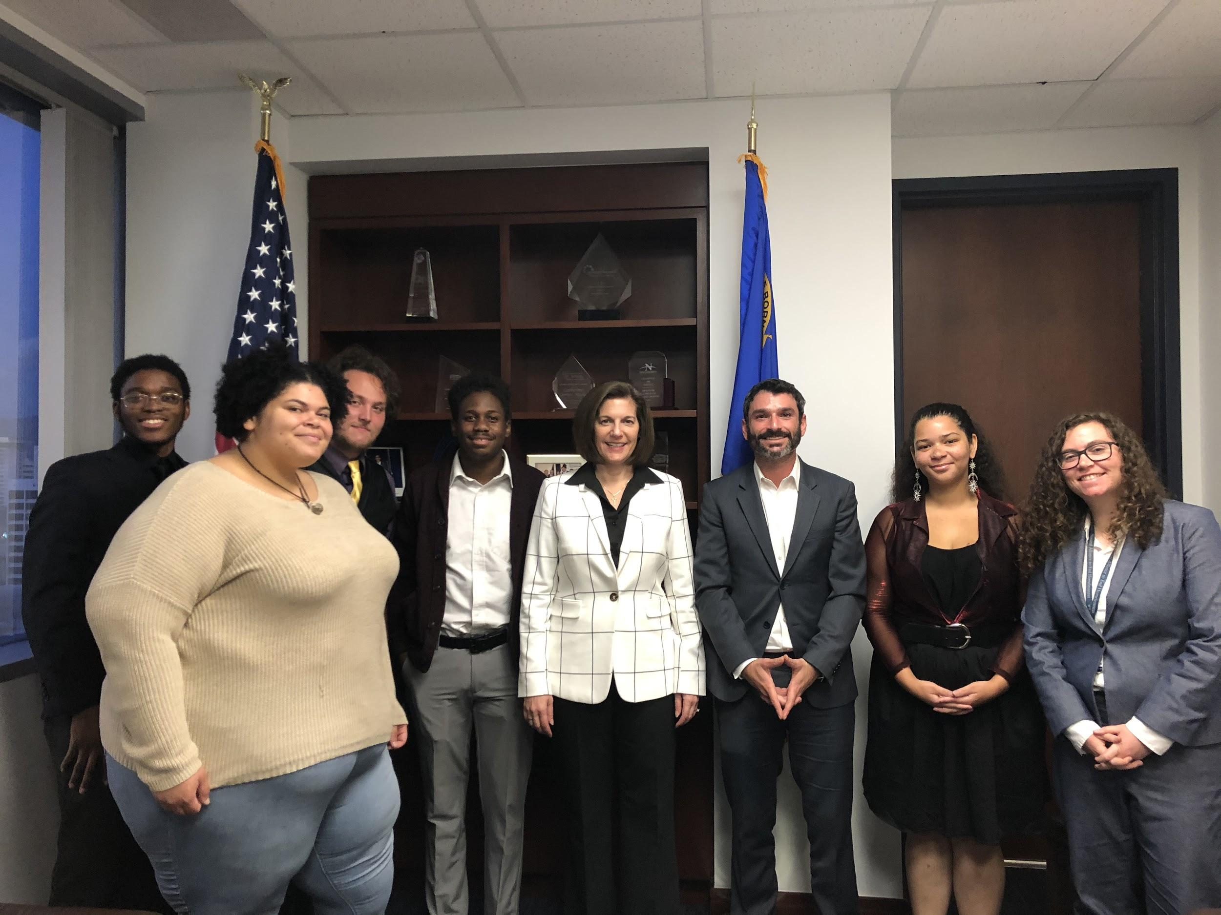
Why is YAC Important?
Young Adults in Charge or YAC was created on the principles of youth advocacy from a youth standpoint.
Empowering youth voices
Valuable youth insight
Inform policy
Educating community
Breaking down stereotypes
Notes:
-Empowering youth voices attracts a wide variety of youth perspectives on an issue that doesn’t have a “one size fits all” solution (also provides leadership development opportunities for youth)
-Valuable youth insight is significant when the CoC makes decisions that directly affect youth
-For YAC to have a seat at the table means that solutions can be formed with the aid of those who have been impacted firsthand by youth homelessness

Slide 6

Accomplishments
1st ever plan to end youth homelessness in Southern Nevada (20% strategies made by YAC)
Community outreach (including Feel Good Friday)
Help Hope Home interviews/newsletter
Meeting with public officials
2018 & 2019 S. NV Youth Homelessness Summits
Notes:
-The development of the Plan was a community-wide effort with contributions from over 45 organizations including YAC
-Our members reviewed every strategy and sat on the highest level (the joint decision making team) during the planning process
-The Plan was officially released during the 2018 Southern Nevada Youth Homelessness Summit

Slide 7
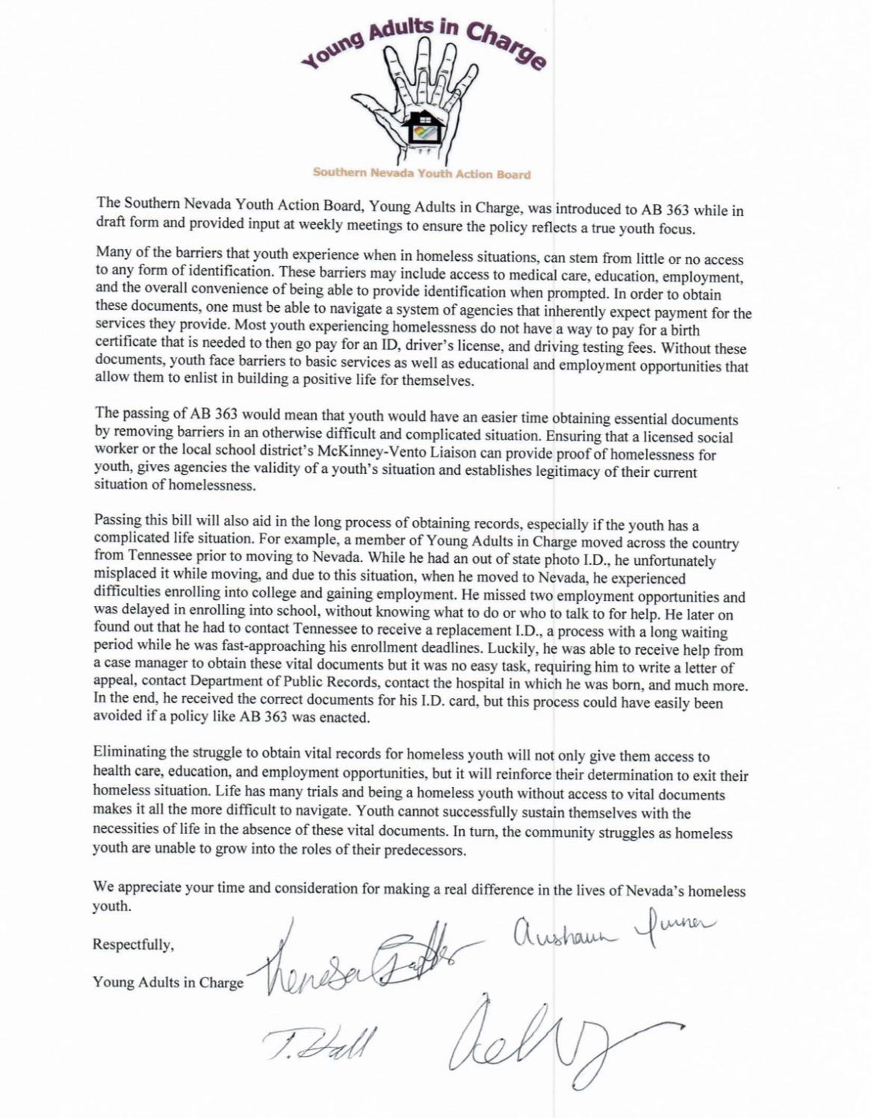
Accomplishments Cont.
AB 363
Regular attendance of Youth Working Group
meetings with voting seat
CoC Board Membership with voting seat
2019 & 2020 PIT Count
Letter of opposition (LV City Council Ordinance)
Notes:
-AB 363 allows for youth to get a one-time fee waiver for their original or duplicate vital document (i.e birth certificate, social security card, ID, drivers license, etc.)
-During the development of the Plan, YAC identified the complicated process to obtaining these documents to be a barrier making it more difficult for youth to gain employment and education and safely exit their homeless situation into self-sufficiency
-Our members were involved in every step from ideation to the language of the bill to testifying in front of elected officials during the 2019 Legislative Session which garnered the support of the entire Nevada State Legislature granting its passage

Slide 8
What can you do??
Volunteer within the community to assist youth agencies
Encourage Membership (ages 15-24)
Advocate to break down stereotypes in your community
Invite YAC to participate in your agency’s activities
Invite YAC to present a training
Notes:
Add slide regarding rules of engagement/activities?

Slide 9
YAC Engagement
Expectations:
Requests from the community to YAC should be directed through YAC’s email
Uphold YAC’s values including respecting the privacy and boundaries of any and all YAC members
Types of engagement:
Attend a meeting
Provide Trainings
Media Request
*All event detail changes must be communicated through our email address in a timely manner
Notes:
Consider ground rules for how YAC can be contacted. See YAC Manual for details (values, requests for presentations, etc.).
Video for other groups outside of CoC?

Slide 10

When are Meetings?
YAC Meetings are held every
other Tuesday
from 5:00 p.m. to 6:00 p.m.
remotely via Google Hangouts.
Contact YAC for more details!

Slide 11
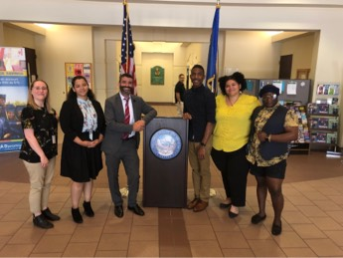
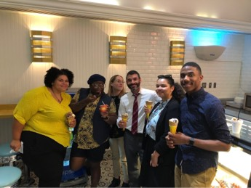
Thank You!
Stay Engaged!
Write Us!
Email: youngadultsincharge@gmail.com
Notes:
Questions/Comments

Slide 12
Sources
https://files.hudexchange.info/resources/documents/2019-AHAR-Part-1.pdf
https://files.hudexchange.info/reports/published/CoC_HIC_State_NV_2019.pdf

